Slide 1
Chapter 2
Describing Distributions of Data

Slide 2
Section 2.1
Displaying Distributions with Graphs What are some types of graphs we used to display data?

Slide 3
Types of Graphs
Bar graph and Pie Chart: good for categorical variables
Histograms, Dot Plots, and Stemplots: good for quantitative variables.

Slide 4
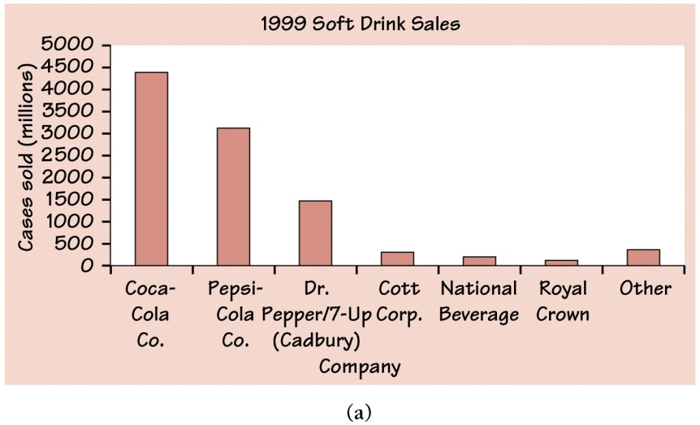
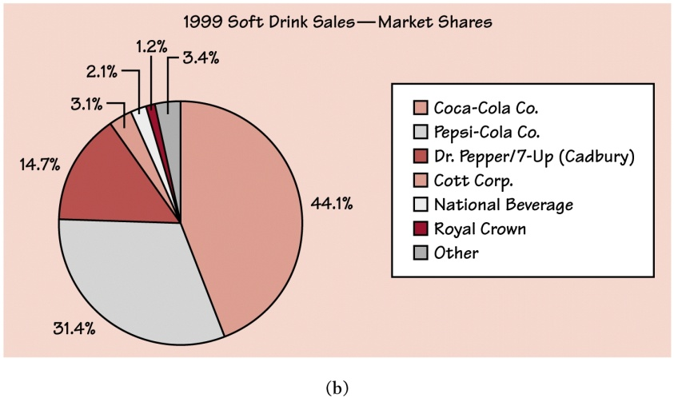
Examples of Graphs
Bar graph: height of
bars shows the counts
in each category.
Pie Chart: allows us to
see what part of the whole
each group forms.

Slide 5
How to make a Bar Graph
1. Label your axes and title your graph.
2. Scale your axes.
3. Draw a vertical bar above each category to help you scale vertical axis.
TIP: Leave equal spaces between the bars in a bar graph.

Slide 6
Graphs: Good and Bad
Bar graphs compare several quantities by comparing the heights of bars that represent those quantities.
Our eyes react to the area of the bars as well as height. Be sure to make your bars equally wide.
Alternate Example
This ad for DIRECTV has multiple problems. How many can you point out?
Notes:
Alternate Example: The following ad for DIRECTV has multiple problems. See how many your students can point out. First, the heights of the bars are not accurate. According to the graph, the difference between 81 and 95 is much greater than the difference between 56 and 81. Also, the extra width for the DIRECTV bar is deceptive since our eyes respond to the area, not just the height.
6

Slide 7
Graphs: Good and Bad
Some graphs can be deciving or misleading.
Same data shown two different ways
Notes:
Alternate Example: The following ad for DIRECTV has multiple problems. See how many your students can point out. First, the heights of the bars are not accurate. According to the graph, the difference between 81 and 95 is much greater than the difference between 56 and 81. Also, the extra width for the DIRECTV bar is deceptive since our eyes respond to the area, not just the height.
7

Slide 8
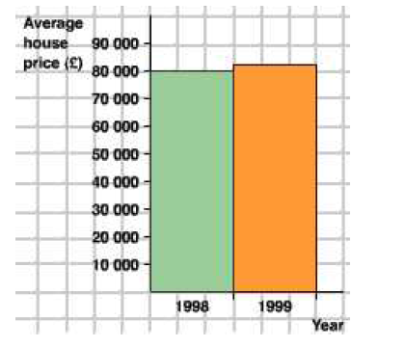
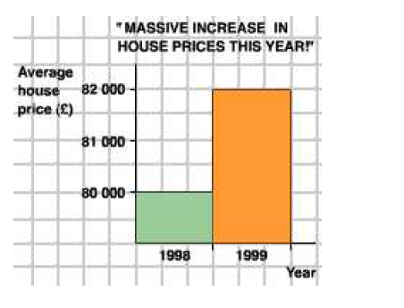
Graphs: Good and Bad
Some graphs can be deciving or misleading.
Same data shown two different ways
Notes:
Alternate Example: The following ad for DIRECTV has multiple problems. See how many your students can point out. First, the heights of the bars are not accurate. According to the graph, the difference between 81 and 95 is much greater than the difference between 56 and 81. Also, the extra width for the DIRECTV bar is deceptive since our eyes respond to the area, not just the height.
8

Slide 9
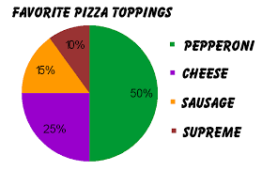
How to create a pie chart
Draw a circle
Calculate the area of each part of the circle by taking the percentage of each cateogry and converting it to a decimal and then multiplying by 360.

Slide 10
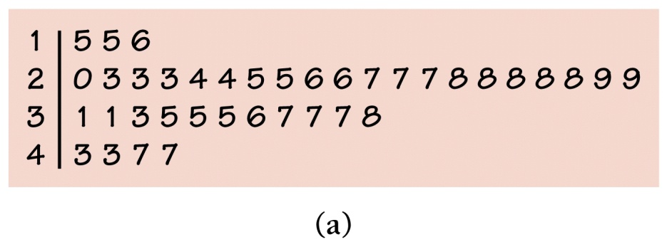
Examples of Graphs (cont.)
Dot Plots.
Stemplots

Slide 11
How to construct a dotplot
1. Label your axis and title your graph.
2. Draw a horizontal line and label it with the
variable.
3. Scale the axis based on the values of the
variable.
4. Mark a dot above the number on the
horizontal axis corresponding to each data
value.

Slide 12
How to construct a stemplot
1. Separate each observation into a stem, consisting of all but the rightmost digit and, a leaf, the final digit.
2. Write the stems vertically in increasing order from top to bottom, and draw a vertical line to the right of the stems.
3. Go through the data, writing each leaf to the right of its stem in increasing order.
4. Title your graph and add a key.

Slide 13
Stemplots
Advantages:
-easy to construct
-displays actual data value (unless we round)
Disadvantages:
-lose info about the data
-does not work well with large data sets
-Because of technology, it has become easy to construct histograms which provide a better look at the data.

Slide 14
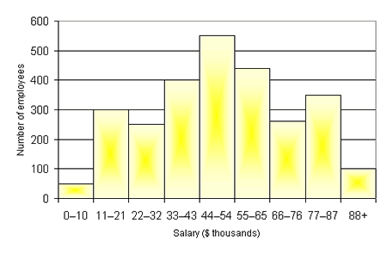
Examples of Graphs (cont.)
Histograms
Dot Plots

Slide 15
How to create a histogram
Minimum of 5 classes
Group data into classes
Count the number of observations in each class
Each class must be of equal width
Label and scale axes. Vertical axis contains the scale of counts, horizontal axis contains classes
Draw a bar to represent count in each class. No horizontal space between bars.
Add a “break-in scale” symbol if axis does not start at zero.

Slide 16
Why the minimum of 5 classes?
Too few classes will give a “skyscraper” graph, with all values in a few classes with tall bars.
Too many will produce a “pancake” graph, with most classes having one or no observations.

Slide 17
3 ways histograms can be misleading
Vertical axis is not proportional
Categorical axis or classes are not the same size
Vertical axis does not start at zero.

Slide 18
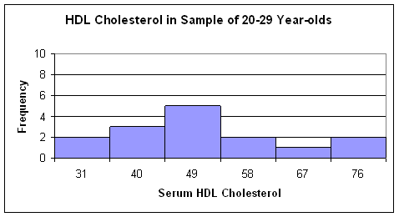
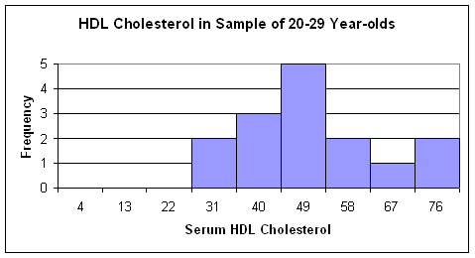
Misleading histograms

