Slide 1
Least-Squares Regression
Section 3.3

Slide 2
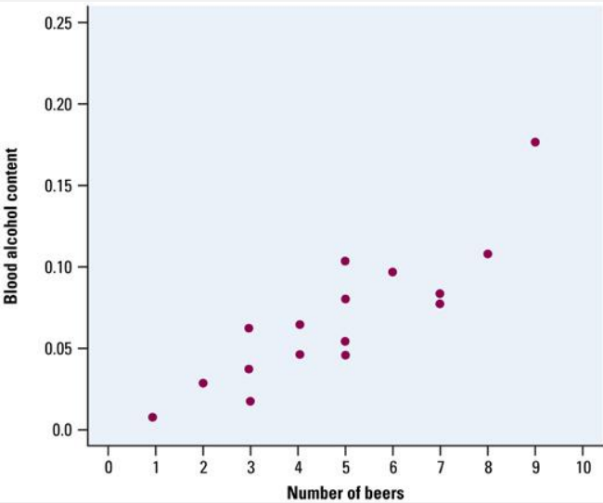
Least-Squares Regression
When a scatterplot shows a linear relationship, we would like to summarize the overall pattern by drawing a line on the scatterplot.

Slide 3
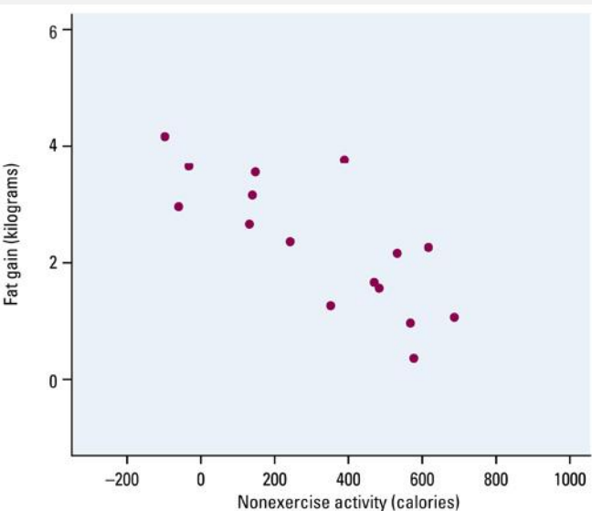
Does fidgeting keep you slim?
Can fidgeting and other “nonexercise activity (NEA)” explain why some people don’t gain weight after overeating?
Here is data on nonexercise activities (NEA) and weight gain (measured in kilograms). We’ll refer to this for the next few slides.

Slide 4
Does fidgeting keep you slim?
Make a scatterplot. Describe the relationship? Is there a positive or negative association? Is the relationship approximately linear?
Calculate Numerical Summaries
Now, let’s use a mathematical model to represent the data (we'll use a line!)

Slide 5
The Least-Squares Regression Line
So we want to draw a line as a model to represent our data (like density curves represented univariate data distributions in the previous chapter.)
But no line will go through all the points and my line drawn by eye might be different than yours.
So...

Slide 6
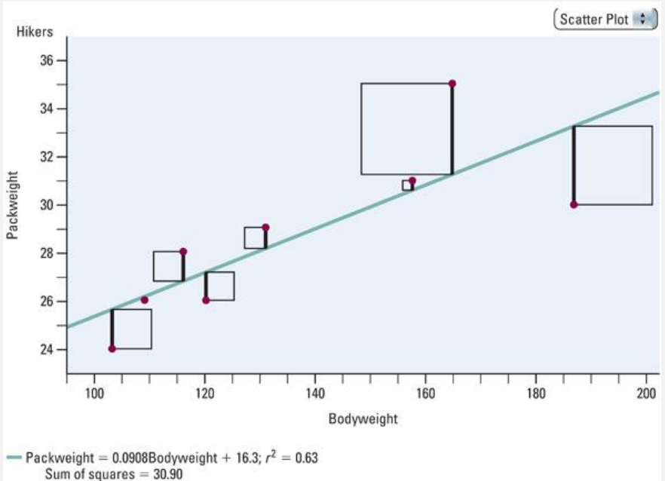
The Least-Squares Regression Line (the LSRL)
...find the line that reduces the vertical distances (squared so we don't deal with negatives) from the point to the line.

Slide 7
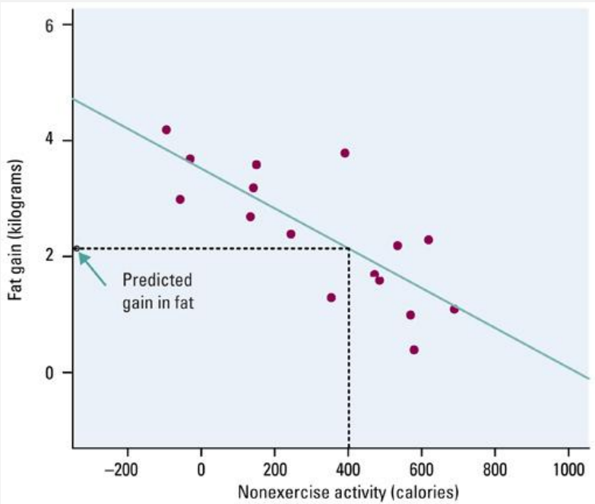
Using the LSRL
Given a LSRL, we want to be able to interpret it and use it.
y ˆ = 3.505 -0.00344 x
Interpreting the slope: The slope tells us what?
For every added calorie of NEA, fat gain goes down by -0.00344 kilograms (or -3.44 grams).
Interpreting the y-intercept: The y-intercept tells us what?
The y-intercept (3.505 kg) is the estimated fat gain if NEA does not change when a person overeats.

Slide 8
Using the LSRL for predictions
Use the graph to predict values.
What is the fat gain for a person whose NEA increases by 400 calories?
Or use the equation to predict values.
Plug 400 into the equation.
y ˆ = 3.505 -0.00344 x

Slide 9
Using the LSRL for predictions
Use the LSRL to predict the fat gain for someone whose NEA increases by 1500 calories. Then interpret your results.
y ˆ = 3.505 - 0.00344 x

Slide 10
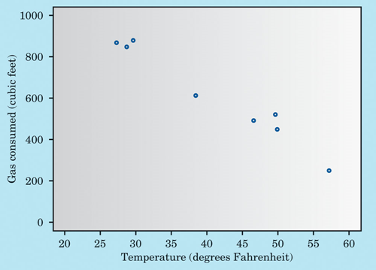
Enter the data from our previous example. We'll let the calculator find our regression line.
What is the correlation value?
Month | Oct | Nov | Dec | Jan | Feb | Mar | Apr | May
Temp (x) | 49.4 | 38.2 | 27.2 | 28.6 | 29.5 | 46.4 | 49.7 | 57.1
Gas consumed (y) | 520 | 610 | 870 | 850 | 880 | 490 | 450 | 250

Slide 11
Cautions about Regression
Describe only linear relationships
Prediction outside the range of the available data is risky (interpolation vs. extrapolation)
Both are strongly affected by outliers
Regression line always passes through the point (x-bar,y-bar)
Switching x and y has no effect on correlation, but it does affect regression

Slide 12
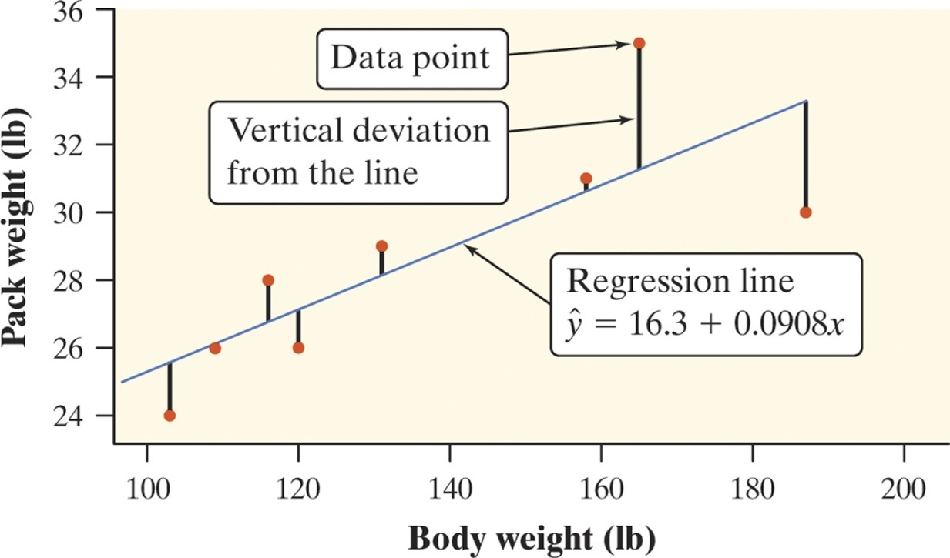
Least-Squares Regression
Residuals
In most cases, no line will pass exactly through all the points in a scatterplot. A good regression line makes the vertical distances of the points from the line as small as possible.
Definition:
A residual is the difference between an observed value of the response variable and the value predicted by the regression line. That is,
residual = observed y – predicted y
residual = y - ŷ
Positive residuals
(above line)
residual
Negative residuals
(below line)

Slide 13
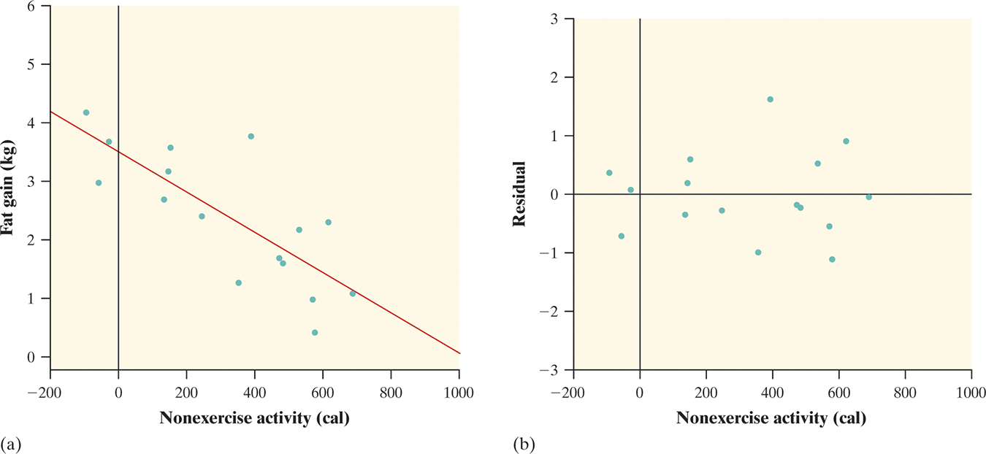
Least-Squares Regression
Residual Plots
One of the first principles of data analysis is to look for an overall pattern and for striking departures from the pattern. A regression line describes the overall pattern of a linear relationship between two variables. We see departures from this pattern by looking at the residuals.
Definition:
A residual plot is a scatterplot of the residuals against the explanatory variable. Residual plots help us assess how well a regression line fits the data.

Slide 14
Understanding prediction: residuals
A residual is the difference between an observed value of the response variable and the value predicted by the regression line.
residual = observed y - predicted y

Slide 15
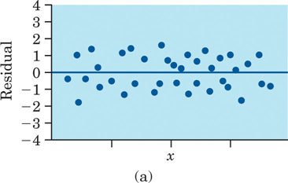
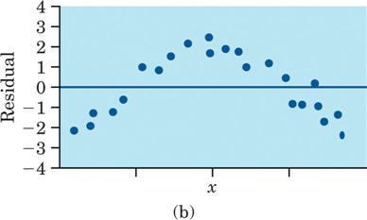
Understanding prediction: residuals
A residual plot should show no obvious pattern
The residuals should be relatively small in size
Figure 4.23
Two residual plots. In (a), the unstructured scatter of points indicates that the regression line fits the data well. In (b), the residuals have a curved pattern, so a straight line may not be the best model for the data.

Slide 16
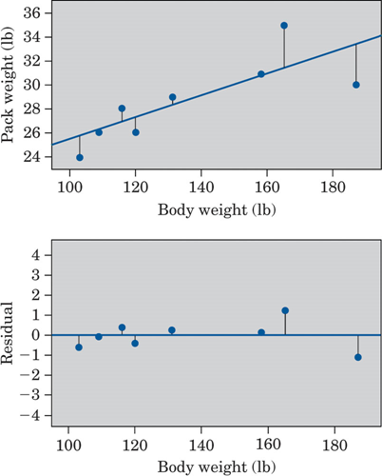
Figure 4.22
Scatterplot with least-squares line and a separate residual plot for the hiker data.

Slide 17
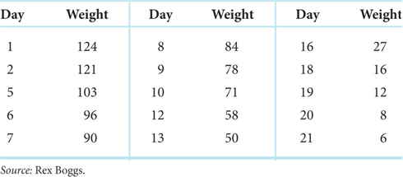
Weight (Grams) of a Bar of Soap Used to Shower
Use the calculator to see our scatterplot with regression line and our residual plot.

Slide 18
Understanding prediction: r²
The square of the correlation, r², is the fraction of the variation in the values of y that is explained by the least- squares regression of y on x
A value of r² = 0.632 means about 63% of the observed variation in pack weight is explained by the straight-line pattern.
This is a measure of how successful the regression was in explaining the response.

Slide 19
Cautions about Correlation and Regression
Correlation and regression describe only linear relationships.
Correlation and LSRL are not resistant.
Extrapolation: use of a regression line for prediction far outside the domain of values of the explanatory variable that you used to obtain the line or curve; such predictions are often not accurate
Lurking Variables: a variable that is not among the explanatory or response variables in a study and yet may influence the interpretation of relationships among those variables
Can falsely suggest a relationship between x and y or can hide a relationship that is really there.
Are often unrecognized and unmeasured, so detecting their effect is a challenge.

Slide 20
Cautions about Correlation and Regression
Using Averaged Data
Correlations based on averages are usually too high when applied to individuals.
So, resist the temptation to apply results of studies that dealt with averages to individuals.
This is another reminder that it is important to note exactly what variables were measured in a statistical study.

Slide 21
Causation
Establishing Causation: When we study the relationship between two variables, we often hope to show that changes in the explanatory variable cause changes in the response variable.
But a strong association between two variables is not enough to draw conclusions about cause and effect.

Slide 22
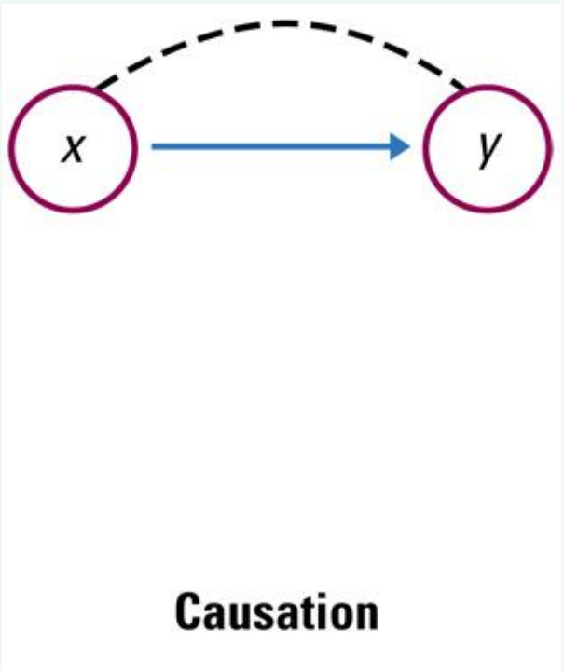
Explaining Association: Causation
A direct cause-and-effect link between variables.
Changes in x cause changes in y.
*Even when direct causation is present, it is rarely a complete explanation of an association
*Even well-established causal relations may not generalize to other settings.
Example: Experiments show conclusively that large amounts of saccharin in the diet cause bladder tumors in rats.

Slide 23
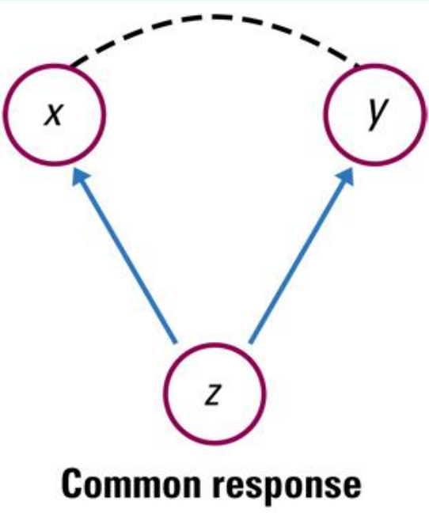
Explaining Association: Common Response
The observed association between the variables x and y is explained by a lurking variable z.
Both x and y change in response to z. z creates an association between x and y, even if there is no direct causal line between x and y.
Example: High SAT scores and high college grades.

Slide 24
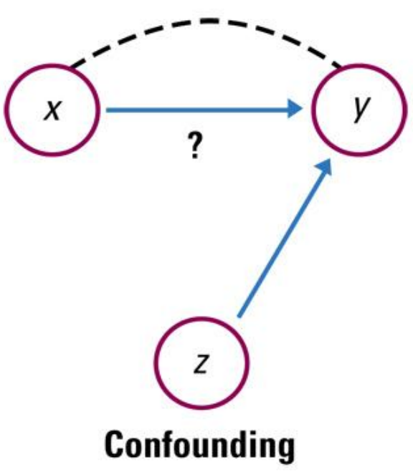
Explaining Association: Confounding
Two variable are confounded when their effects on a response variable cannot be distinguished from each other.
The confounded variables may be either explanatory variables or lurking variables.
Example: Attending religious services regularly and living longer.

Slide 25
Establishing Causation
The best way to ensure correctly established causation is to conduct a carefully designed experiment in which the effects of possible lurking variables are controlled.
In situations where experiments are not possible for ethical or practical reasons, be cautious in accepting claims of causation.

Slide 26
Establishing Causation
Good evidence of causation requires a strong association that appears consistently in many studies, a clear explanation for the alleged causal link, and careful examination of possible lurking variables.

Slide 27
In the 1990's, researchers measured the number of television sets per person x and the life expectancy y for the world's nations. There was a high positive correlation: nations with many TV sets had higher life expectancies.
Does television extend life?

