Slide 1
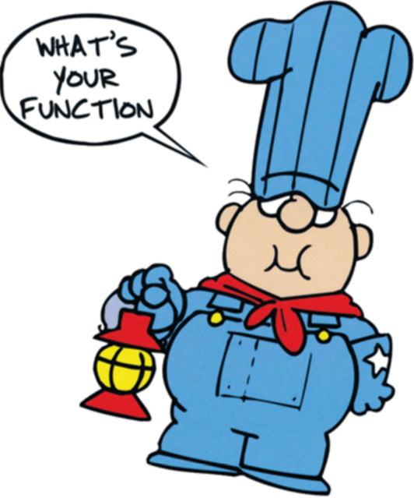
Parent Functions

Slide 2
What will we learn today?
What is a parent function and what types of parent functions are available?
How can we transform parent functions?

Slide 3
Parent Functions
What is a parent function?
The parent function is the simplest function with the defining characteristics of the family.
Multiple functions can be in the same family. They are just transformations of the parent functions.

Slide 4
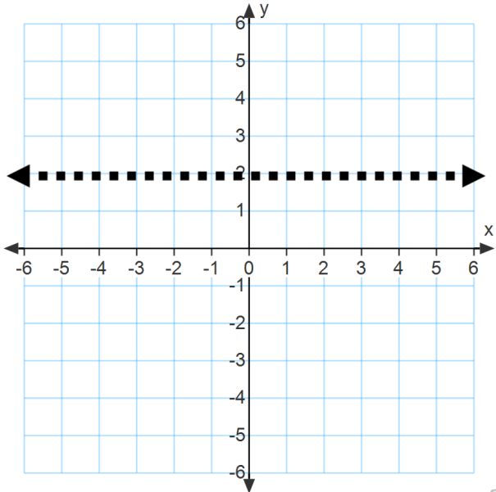
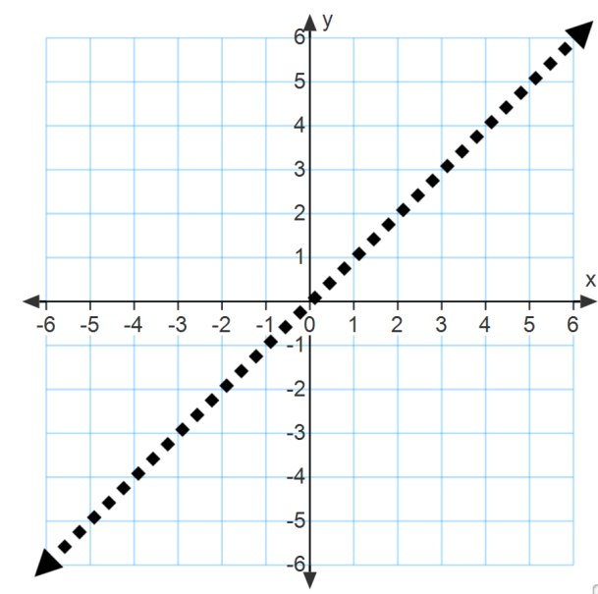
Function Families
Constant
Linear
f(x)=c
f(x)=x
Domain?
Range?
Y-Intercept?
Domain?
Range?
Y-Intercept?

Slide 5
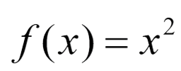
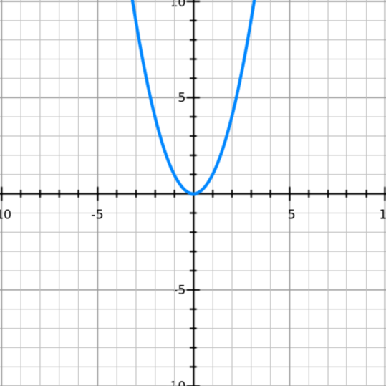
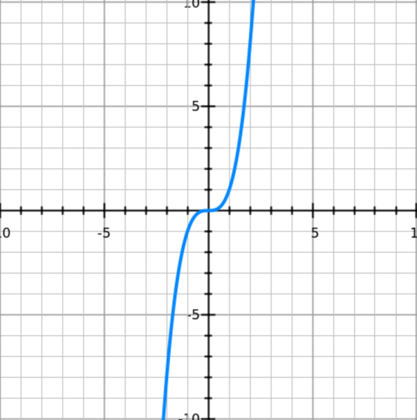
Function Families
Quadratic
Cubic
Domain?
Range?
Y-Intercept?
Domain?
Range?
Y-Intercept?

Slide 6
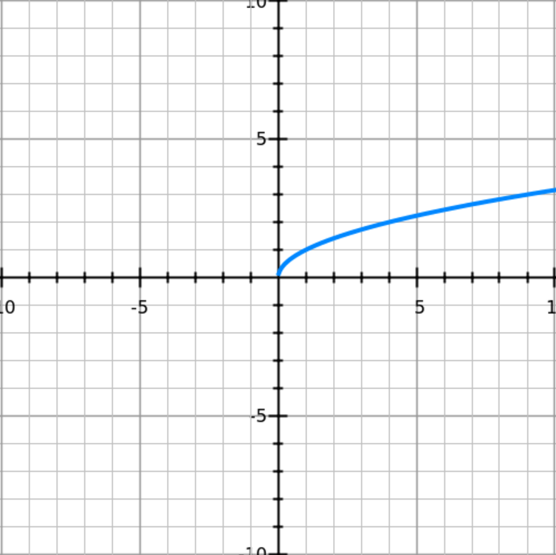
Function Families
Square Root
Domain?
Range?
Y-Intercept?

Slide 7
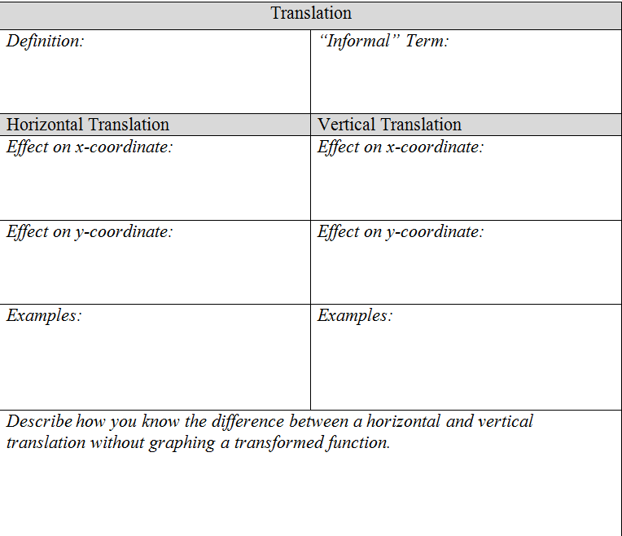

Slide 8
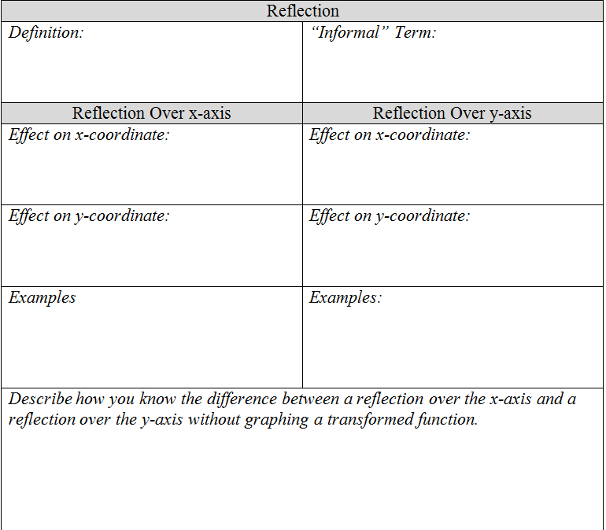

Slide 9
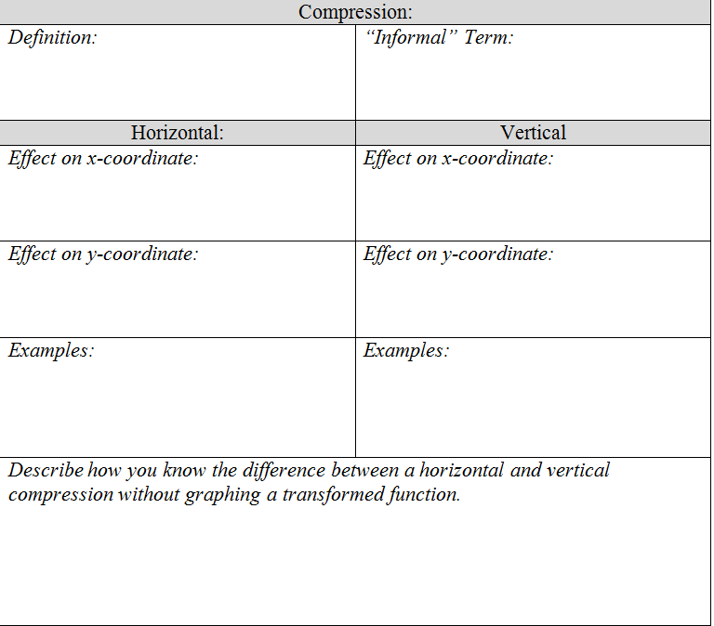

Slide 10
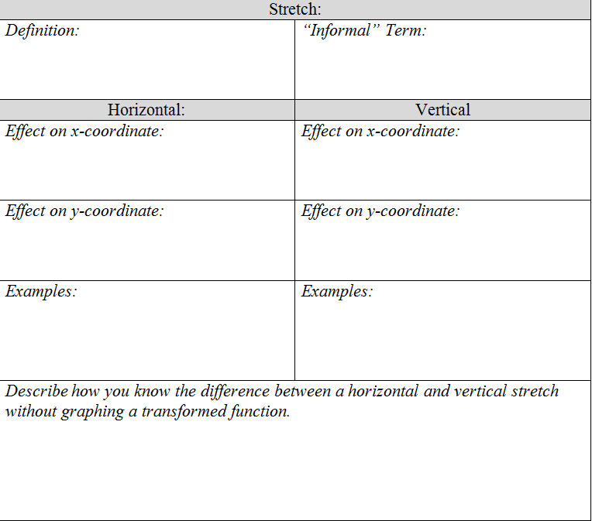

Slide 11
Let’s Try A Few
For each, identify the for g from its function rule. Then, describe what transformation of the parent function it represents.
A)
B)

Slide 12
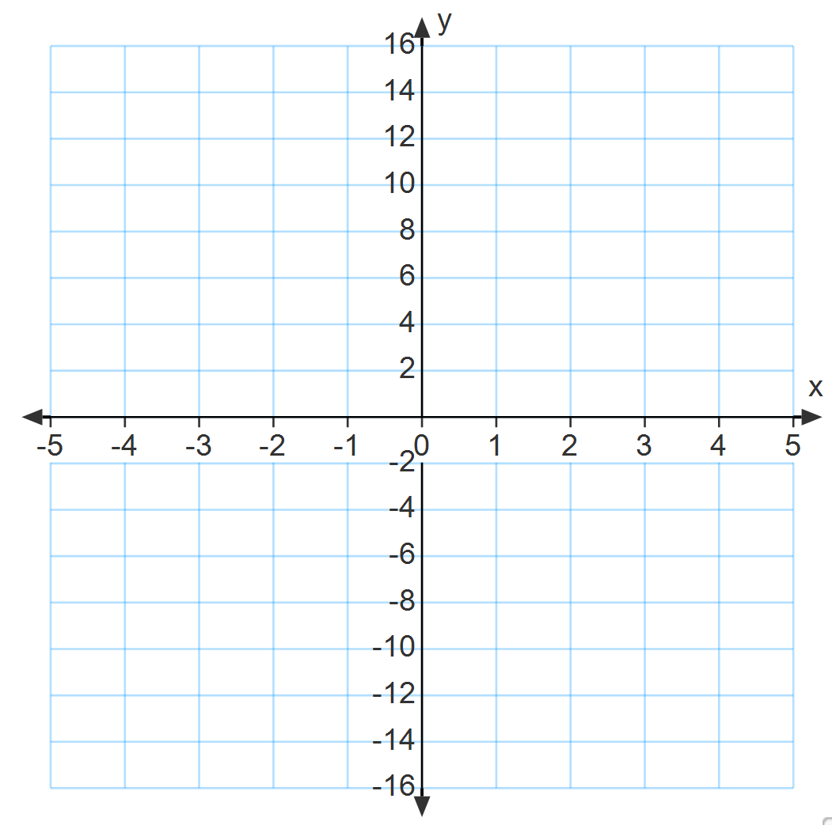
Example 2)
Graph the data from this set of ordered pairs. Describe the parent function and the transformation that best approximates the data set.
[(-2,12), (-1,3), (0,0), (1,3), (2,12)]

Slide 13
The Fun Begins
Let g(x) be the indicated translation of f(x). Write the rule for g(x).
; a vertical translation up 4 units

Slide 14
How about this?
Let g(x) be the indicated translation of f(x). Write the rule for g(x).
Linear function defined in the table; reflection across y-axis
x | f(x)
-1 | 0
0 | 2
1 | 4

Slide 15
Try this on your own!
Let g(x) be a horizontal compression of
by a factor of 1/3. Write the rule for g(x).

Slide 16
Now, for the real fun!
Let g(x) be a vertical shift of f(x)=x down 2 units followed by a vertical stretch by a factor of 5. Write the rule for g(x).

Slide 17
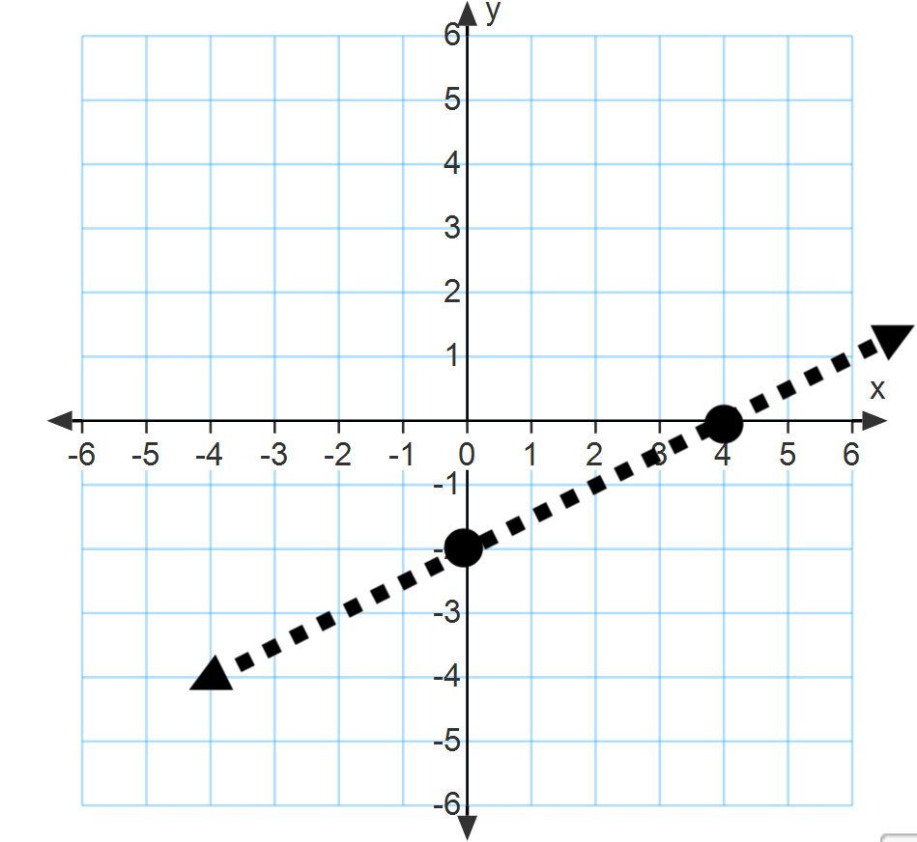
Pop Problem!
Let g(x) be the indicated transformation of f(x). Write the rule for g(x).
Vertical translation down 2 units followed by a horizontal stretch by a factor of 3

