Slide 1
Chapter 2: Modeling Distributions of Data
Section 2.1
Describing Location in a Distribution
The Practice of Statistics, 4th edition - For AP*
STARNES, YATES, MOORE

Slide 2
Chapter 2 Modeling Distributions of Data
2.1 Describing Location in a Distribution
2.2 Normal Distributions

Slide 3
Section 2.1 Describing Location in a Distribution
Learning Objectives
After this section, you should be able to…
MEASURE position using percentiles
INTERPRET cumulative relative frequency graphs
MEASURE position using z-scores
TRANSFORM data
DEFINE and DESCRIBE density curves

Slide 4
Describing Location in a Distribution
Measuring Position: Percentiles
One way to describe the location of a value in a distribution is to tell what percent of observations are less than it.
Definition:
The p^{th} percentile of a distribution is the value with p percent of the observations less than it.
Example, p. 85
Jenny earned a score of 86 on her test. How did she perform relative to the rest of the class?
6 7
7 2334
7 5777899
8 00123334
8 569
9 03
6 7
7 2334
7 5777899
8 00123334
8 569
9 03
Her score was greater than 21 of the 25 observations. Since 21 of the 25, or 84%, of the scores are below hers, Jenny is at the 84th percentile in the class’s test score distribution.

Slide 5
Describing Location in a Distribution
Cumulative Relative Frequency Graphs
A cumulative relative frequency graph (or ogive) displays the cumulative relative frequency of each class of a frequency distribution.
Age of First 44 Presidents When They Were Inaugurated
Age | Frequency | Relative frequency | Cumulative frequency | Cumulative relative frequency
40-44 | 2 | 2/44 = 4.5% | 2 | 2/44 = 4.5%
45-49 | 7 | 7/44 = 15.9% | 9 | 9/44 = 20.5%
50-54 | 13 | 13/44 = 29.5% | 22 | 22/44 = 50.0%
55-59 | 12 | 12/44 = 34% | 34 | 34/44 = 77.3%
60-64 | 7 | 7/44 = 15.9% | 41 | 41/44 = 93.2%
65-69 | 3 | 3/44 = 6.8% | 44 | 44/44 = 100%

Slide 6
Describing Location in a Distribution
Interpreting Cumulative Relative Frequency Graphs
Use the graph from page 88 to answer the following questions.
Was Barack Obama, who was inaugurated at age 47, unusually young?
Estimate and interpret the 65th percentile of the distribution
65
11
47
58

Slide 7
Describing Location in a Distribution
Measuring Position: z-Scores
A z-score tells us how many standard deviations from the mean an observation falls, and in what direction.
Definition:
If x is an observation from a distribution that has known mean and standard deviation, the standardized value of x is:
A standardized value is often called a z-score.
Jenny earned a score of 86 on her test. The class mean is 80 and the standard deviation is 6.07. What is her standardized score?

Slide 8
Describing Location in a Distribution
Using z-scores for Comparison
We can use z-scores to compare the position of individuals in different distributions.
Example, p. 91
Jenny earned a score of 86 on her statistics test. The class mean was 80 and the standard deviation was 6.07. She earned a score of 82 on her chemistry test. The chemistry scores had a fairly symmetric distribution with a mean 76 and standard deviation of 4. On which test did Jenny perform better relative to the rest of her class?

Slide 9
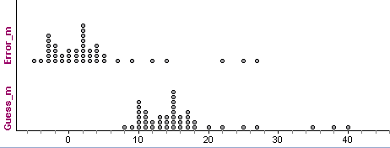
Describing Location in a Distribution
Transforming Data
Transforming converts the original observations from the original units of measurements to another scale. Transformations can affect the shape, center, and spread of a distribution.
Effect of Adding (or Subracting) a Constant
Adding the same number a (either positive, zero, or negative) to each observation:
adds a to measures of center and location (mean, median, quartiles, percentiles), but
Does not change the shape of the distribution or measures of spread (range, IQR, standard deviation).
Example, p. 93
 | n | Mean | s_{x} | Min | Q₁ | M | Q₃ | Max | IQR | Range
Guess(m) | 44 | 16.02 | 7.14 | 8 | 11 | 15 | 17 | 40 | 6 | 32
Error (m) | 44 | 3.02 | 7.14 | -5 | -2 | 2 | 4 | 27 | 6 | 32

Slide 10
Describing Location in a Distribution
Transforming Data
Effect of Multiplying (or Dividing) by a Constant
Multiplying (or dividing) each observation by the same number b (positive, negative, or zero):
multiplies (divides) measures of center and location by b
multiplies (divides) measures of spread by |b|, but
does not change the shape of the distribution
 | n | Mean | s_{x} | Min | Q₁ | M | Q₃ | Max | IQR | Range
Error(ft) | 44 | 9.91 | 23.43 | -16.4 | -6.56 | 6.56 | 13.12 | 88.56 | 19.68 | 104.96
Error (m) | 44 | 3.02 | 7.14 | -5 | -2 | 2 | 4 | 27 | 6 | 32
Example, p. 95

Slide 11
Describing Location in a Distribution
Density Curves
In Chapter 1, we developed a kit of graphical and numerical tools for describing distributions. Now, we’ll add one more step to the strategy.
Exploring Quantitative Data
Always plot your data: make a graph.
Look for the overall pattern (shape, center, and spread) and for striking departures such as outliers.
Calculate a numerical summary to briefly describe center and spread.
4. Sometimes the overall pattern of a large number of observations is so regular that we can describe it by a smooth curve.

Slide 12
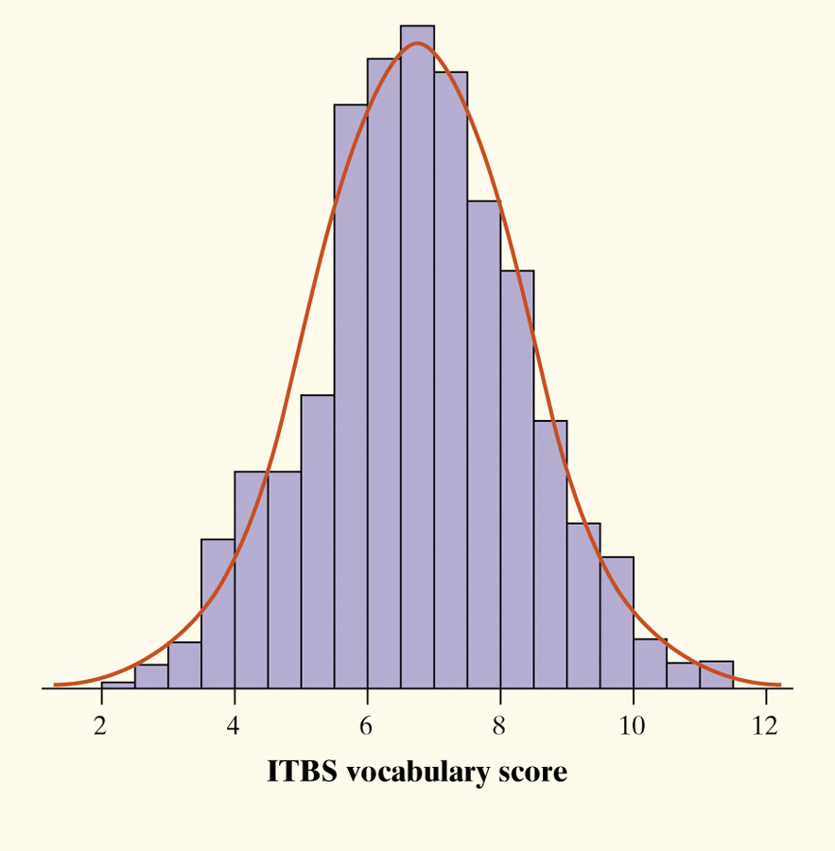
Describing Location in a Distribution
Density Curve
Definition:
A density curve is a curve that
is always on or above the horizontal axis, and
has area exactly 1 underneath it.
A density curve describes the overall pattern of a distribution. The area under the curve and above any interval of values on the horizontal axis is the proportion of all observations that fall in that interval.
The overall pattern of this histogram of the scores of all 947 seventh-grade students in Gary, Indiana, on the vocabulary part of the Iowa Test of Basic Skills (ITBS) can be described by a smooth curve drawn through the tops of the bars.

Slide 13
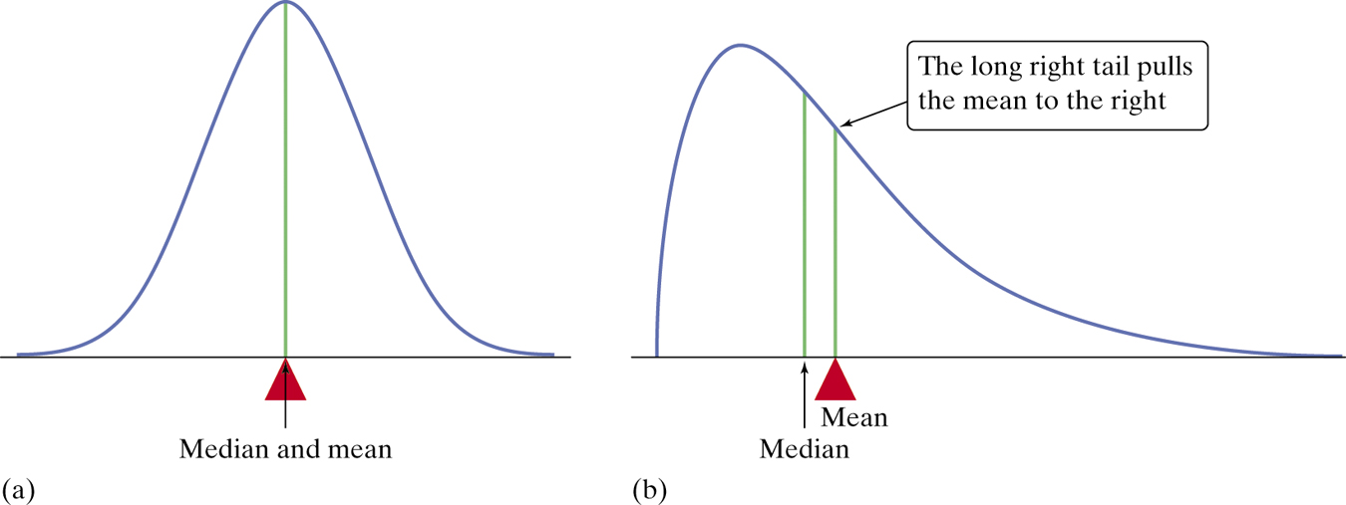
Describing Location in a Distribution
Describing Density Curves
Our measures of center and spread apply to density curves as well as to actual sets of observations.
Distinguishing the Median and Mean of a Density Curve
The median of a density curve is the equal-areas point, the point that divides the area under the curve in half.
The mean of a density curve is the balance point, at which the curve would balance if made of solid material.
The median and the mean are the same for a symmetric density curve. They both lie at the center of the curve. The mean of a skewed curve is pulled away from the median in the direction of the long tail.

Slide 14
Section 2.1 Describing Location in a Distribution
Summary
In this section, we learned that…
There are two ways of describing an individual’s location within a distribution – the percentile and z-score.
A cumulative relative frequency graph allows us to examine location within a distribution.
It is common to transform data, especially when changing units of measurement. Transforming data can affect the shape, center, and spread of a distribution.
We can sometimes describe the overall pattern of a distribution by a density curve (an idealized description of a distribution that smooths out the irregularities in the actual data).

Slide 15
Looking Ahead…
In the next Section…
We’ll learn about one particularly important class of density curves – the Normal Distributions
We’ll learn
The 68-95-99.7 Rule
The Standard Normal Distribution
Normal Distribution Calculations, and
Assessing Normality

