Slide 1
Quadratics
Section 2.1/2.2

Slide 2
What questions will we answer?
How can we transform a quadratic function?
What are the key features of a quadratic function?
How can we solve a quadratic equation by graphing?

Slide 3
Where to Begin?
Throughout this entire chapter, we will be analyzing quadratic functions.
A quadratic function is a function that can be written in the form of .

Slide 4
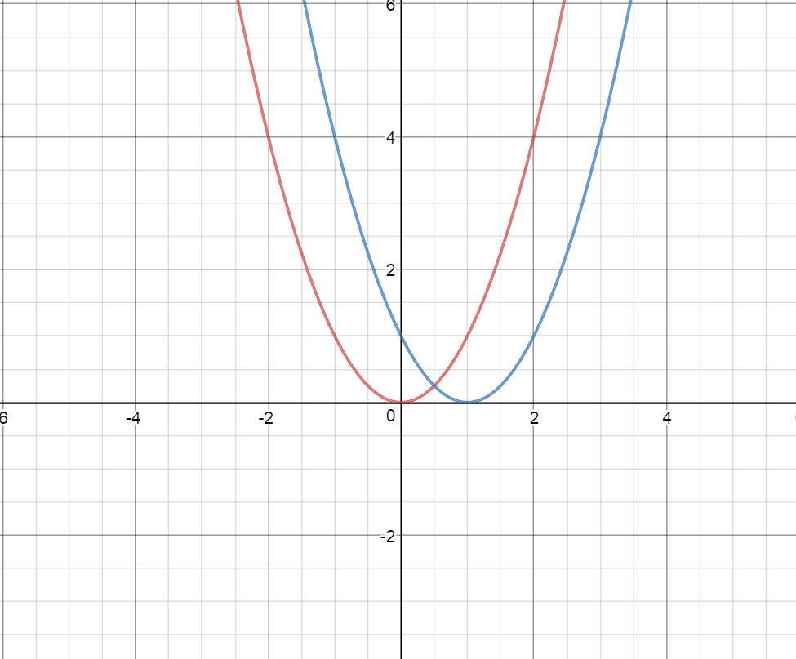
Let’s Explore!
What conclusion can you make from our exploration?
(x-1)²
x²

Slide 5
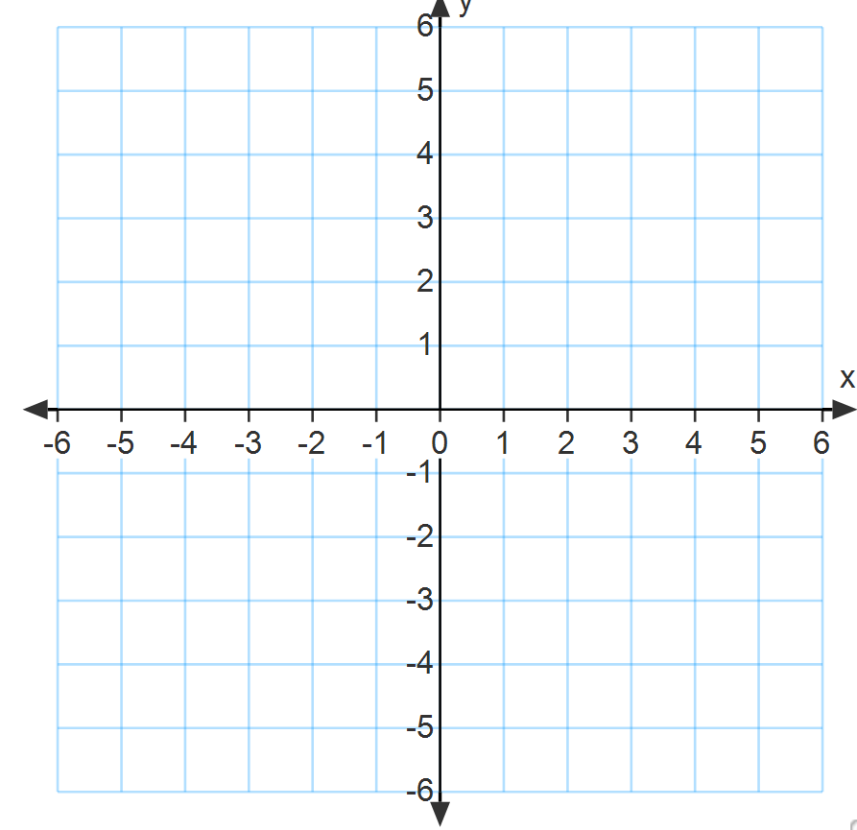
Your Turn!
What would the graph of look like?
Each of our quadratic functions form graphs that are parabolas, or U-shaped curves.

Slide 6
Thinking Further….
What would you expect following graph to look like?

Slide 7
Try this on your own
Graph the following:
A)
B)

Slide 8
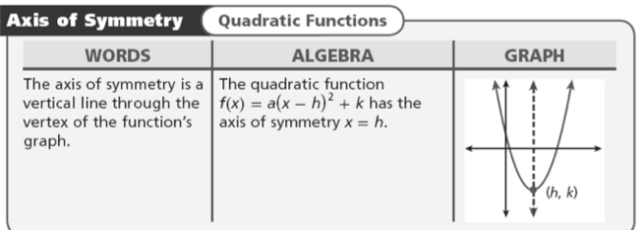
Deeper into the Mystery
Quadratics have key features that describe its characteristics. For each transformation, these may differ.
One such feature is the axis of symmetry.
The axis of symmetry is the line through the vertex of a parabola that divides the parabola into two congruent halves.

Slide 9
Example 1
Identify the axis of symmetry for

Slide 10
Try This!
Identify the axis of symmetry for

Slide 11
More Feature Fun!
Our quadratics functions have been in the same form; Vertex form.
Go back to our last two examples and find the vertex of each parabola.

Slide 12
Another Form Exists!
Standard Form!!
The standard form of a quadratic function is
, where a ≠ 0.
Convert the following quadratic function from vertex form to standard form. Then, let’s look at the graph.

Slide 13
Notice Anything?
What does the value of a tell you about how the parabola will open? What can you expect if a is negative?
What does the value of c represent?

Slide 14
Properties of a Parabola

Slide 15
Example 2
Consider the function .
a. Determine whether the graph opens upward or downward.
It opens __________________.
b. Find the axis of symmetry.
The axis of symmetry is ______________.

Slide 16
Example 2
c. Find the vertex.
The vertex is ___________.
d. Find the y-intercept.
The y intercept is _______________.

Slide 17
You’re Up!
Determine whether the graph opens upward or downward.
Find the axis of symmetry.
Find the vertex.
Find the y-intercept.

Slide 18
Pop Problem
First 3 correct answers only!
Write the function below in standard form. THEN, find the axis of symmetry, vertex,
y-intercept and if the parabola open upward or downward.

Slide 19
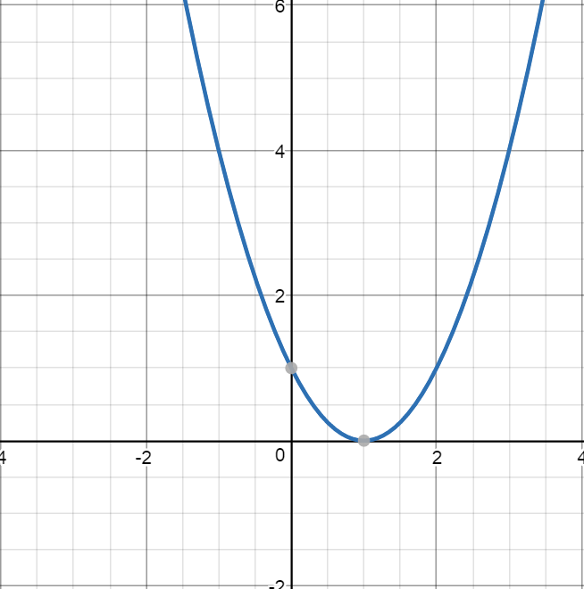
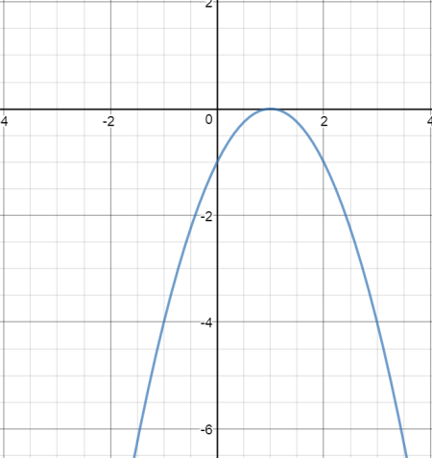
Max and Min
If a graph opens upward, it will have a minimum y-value at the y-coordinate of the vertex.
If the graph opens downward, it will have a maximum y-value at the y-coordinate of the vertex.

Slide 20
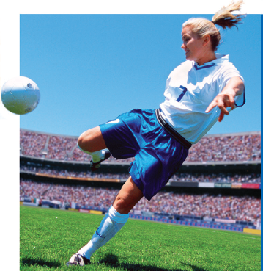
One Last Thought
When a soccer ball is kicked into the air, how long will the ball take to hit the ground? The height h in feet of the ball after t seconds can be modeled by the quadratic function h(t) = –16t² + 32t. In this situation, the value of the function represents the height of the soccer ball. When the ball hits the ground, the value of the function is zero.

Slide 21
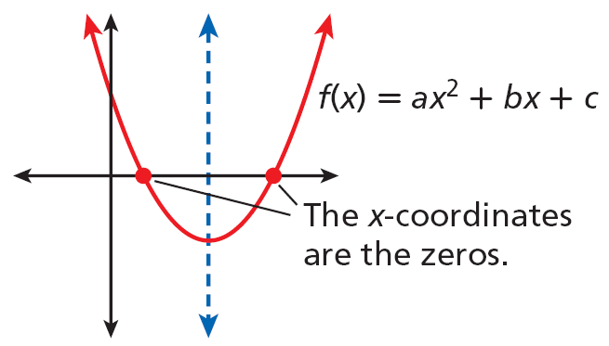
A zero of a function is a value of the input x that makes the output f(x) equal zero. The zeros of a function are the x-intercepts.
Unlike linear functions, which have no more than one zero, quadratic functions can have two zeros, as shown at right. These zeros are always symmetric about the axis of symmetry.

Slide 22
Let’s Find the Zeros Using a Table and a Calculator
Find the zeros of f(x) = x² – 6x + 8 by using a graph and table.

Slide 23
Last One!
Find the zeros of the graph using a table and a graph (calculator).
f(x) = x² – 6x + 8

Slide 24
We Did It!

