Slide 1
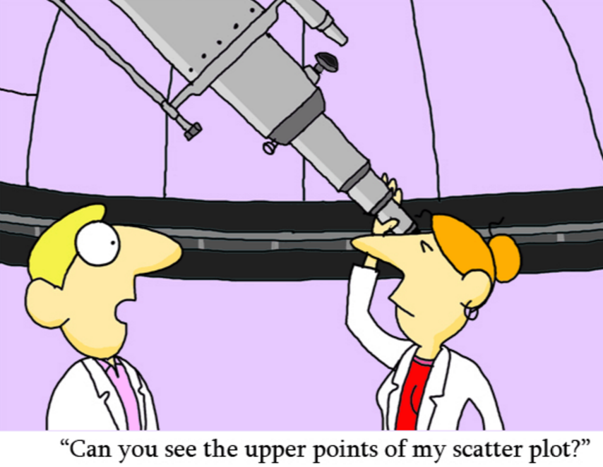

Slide 2
Objectives
Fit scatter plot data using linear models with and without technology.
Use linear models to make predictions.

Slide 3
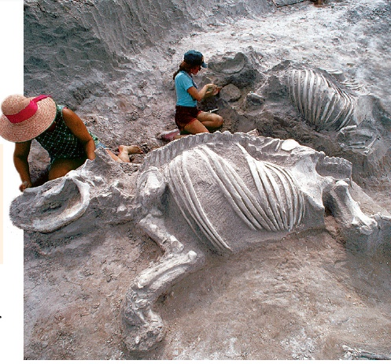
Researchers, such as anthropologists, are often interested in how two measurements are related. The statistical study of the relationship between variables is called regression.

Slide 4
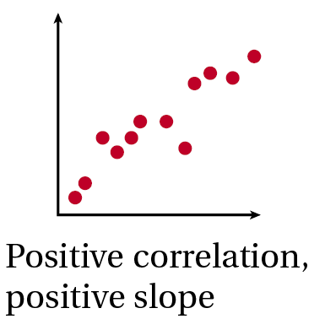
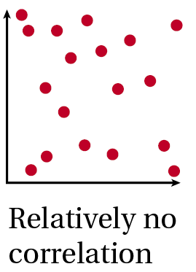
A scatter plot is helpful in understanding the form, direction, and strength of the relationship between two variables. Correlation is the strength and direction of the linear relationship between the two variables.

Slide 5
If there is a strong linear relationship between two variables, a line of best fit, or a line that best fits the data, can be used to make predictions.
Helpful Hint
Try to have about the same number of points above and below the line of best fit.

Slide 6
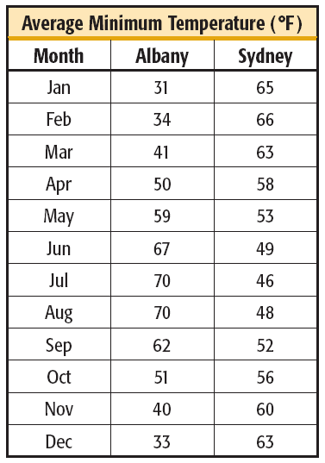
Example 1: Meteorology Application
Albany and Sydney are about the same distance from the equator. Make a scatter plot with Albany’s temperature as the independent variable. Name the type of correlation. Then sketch a line of best fit and find its equation.

Slide 7
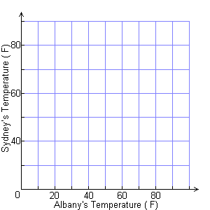
Example 1 Continued
Step 1 Plot the data points.
Step 2 Identify the correlation.
o
Notice that the data set is negatively correlated–as the temperature rises in Albany, it falls in Sydney.
•
•
•
•
•
•
•
•
•
•
•
o

Slide 8
Example 1 Continued
Step 3 Sketch a line of best fit.
Draw a line that splits the data evenly above and below.
o
•
•
•
•
•
•
•
•
•
•
•
o

Slide 9
Example 1 Continued
Step 4 Identify two points on the line.
For this data, you might select (35, 64) and (85, 41).
Step 5 Find the slope of the line that models the data.
Use the point-slope form.
y – y₁= m(x – x₁)
Point-slope form.
y – 64 = –0.46(x – 35)
Substitute.
y = –0.46x + 80.1
Simplify.
An equation that models the data is y = –0.46x + 80.1.

Slide 10
Check It Out! Example 1
Identify the correlation, sketch a line of best fit, and find its equation for your group’s Racecar data.

Slide 11
The correlation coefficient r is a measure of how well the data set is fit by a model.

Slide 12
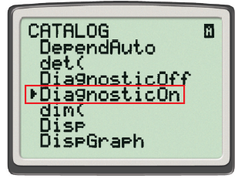
You can use a graphing calculator to perform a linear regression and find the correlation coefficient r.
To display the correlation coefficient r, you may have to turn on the diagnostic mode. To do this, press and choose the DiagnosticOn mode.

Slide 13
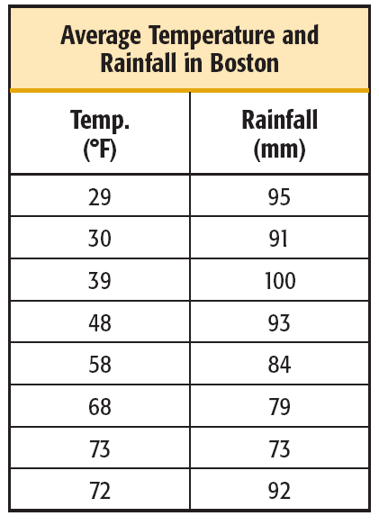
Example 2: Meteorology Application
Find the following for this data on average temperature and rainfall for eight months in Boston, MA.

Slide 14
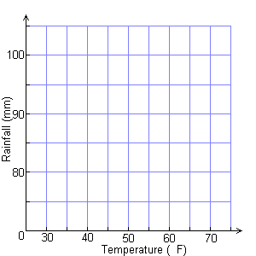
Example 2 Continued
a. Make a scatter plot of the data with temperature as the independent variable.
The scatter plot is shown on the right.
•
•
•
•
•
•
•
•
o

Slide 15
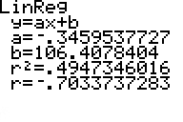
Example 2 Continued
b. Find the correlation coefficient and the equation of the line of best fit. Draw the line of best fit on your scatter plot.
The correlation coefficient is
r = –0.703.
•
•
•
•
•
•
The equation of the line of best fit is y ≈ –0.35x + 106.4.
•
•
o

Slide 16
Example 2 Continued
c. Predict the temperature when the rainfall is 86 mm. How accurate do you think your prediction is?
86 ≈ –0.35x + 106.4
Rainfall is the dependent variable.
–20.4 ≈ –0.35x
58.3 ≈ x
The line predicts 58.3°F, but the scatter plot and the value of r show that temperature by itself is not an accurate predictor of rainfall.

Slide 17
Example 3: Using technology
Now, use the graphing calculator to determine the correlation coefficient of your data. Also, determine the line of best fit using the linear regression function.

Slide 18
Use the line of best fit you constructed and the linear regression function to determine two predictions of how far the race car will travel when the ramp is at a height of 18 inches. How does your prediction compare to the model?

Slide 19
Check It Out! Example 3
c. Predict the amount of fat in a sandwich with 420 Calories. How accurate do you think your prediction is?
420 ≈ 11.1x + 309.8
Calories is the dependent variable.
110.2 ≈ 11.1x
9.9 ≈ x
The line predicts 10 grams of fat. This is not close to the 15 g in the table.

Slide 20
Reading Math
A line of best fit may also be referred to as a trend line.

Slide 21
Check It Out! Example 3
Find the following information for this data set on the number of grams of fat and the number of calories in sandwiches served at Dave’s Deli.
Use the equation of the line of best fit to predict the number of grams of fat in a sandwich with 420 Calories. How close is your answer to the value given in the table?

Slide 22
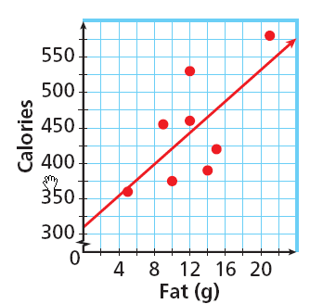
Check It Out! Example 3
a. Make a scatter plot of the data with fat as the independent variable.
The scatter plot is shown on the right.

Slide 23
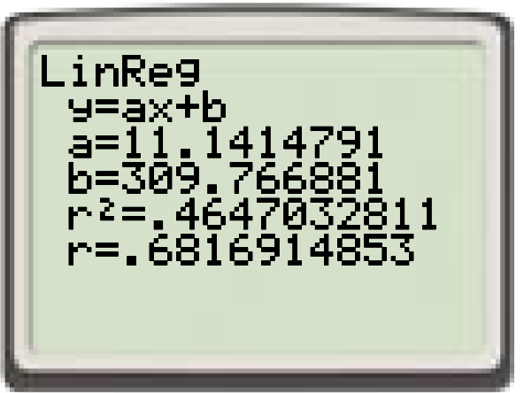
Check It Out! Example 3
b. Find the correlation coefficient and the equation of the line of best fit. Draw the line of best fit on your scatter plot.
The correlation coefficient is r = 0.682. The equation of the line of best fit is y ≈ 11.1x + 309.8.

Slide 24
Check It Out! Example 3
c. Predict the amount of fat in a sandwich with 420 Calories. How accurate do you think your prediction is?
420 ≈ 11.1x + 309.8
Calories is the dependent variable.
110.2 ≈ 11.1x
9.9 ≈ x
The line predicts 10 grams of fat. This is not close to the 15 g in the table.

