Slide 1
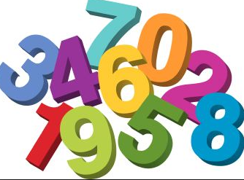
Describing Distributions with Numbers
Section 2.2

Slide 2
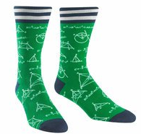
SOCS
Shape
Outliers
Center
Spread

Slide 3
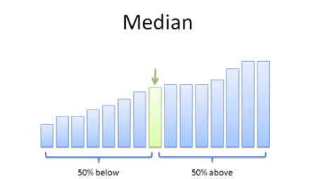
Median
A method of measuring the center of a distribution
The “middle number” or midpoint in a quantitative data set.
How to find the median:
Arrange all the observations in order of size, from smallest to largest
If the number of observations n is odd, the median is the center observation
If the number of observations is even, the median is the average of the two center observations

Slide 4
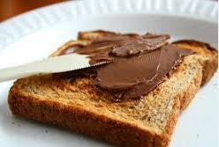
Quartiles: Measuring Spread
How spread out are the data?
One way to measure spread is are the quartiles:
Quartiles: one quarter of the observations lie below the quartile and one quarter of the observations lie above the quartile

Slide 5
Quartiles: Q₁ and Q₃
To find the quartiles:
Arrange the observations in increasing order and locate the median M in the ordered list of observations.
The first quartile Q₁ is the median of the observations whose position in the ordered list is to the left of the location of the overall median.
The third quartile Q₃ is the median of the observations whose position in the ordered list is to the right of the location of the overall median.
The Interquartile Range (IQR) is defined as:
$IQR=Q_{3}−Q_{1}$

Slide 6
Five Number Summary
Consists of:
Minimum
Q₁
Median
Q₃
Maximum

Slide 7
How Many Text Messages?
In a September 28, 2008, article titled “Letting Our Fingers Do the Talking”, the New York Times reported that Americans now send more text messages than they make phone calls. According to a study by Nielsen Mobile, “Teenagers ages 13 to 17 are by far the most prolific texters, sending or receiving 1,742 messages a month.” Mr. Brown, a high school statistics teacher, was skeptical of the texting result stated in the article. So he collected data from his first-period statistics class on the number of text messages they had sent and received in the past 24 hours. Here are the data:
0, 7, 1, 29, 25, 8, 5, 1, 25, 98, 9, 0, 26, 8, 118, 72, 0, 92

Slide 8
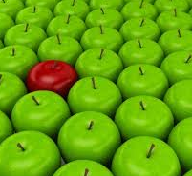
Outliers
Any observation that is 1.5 times the interquartile range (IQR) above Q₃ or below Q₁ is considered an outlier.

Slide 9
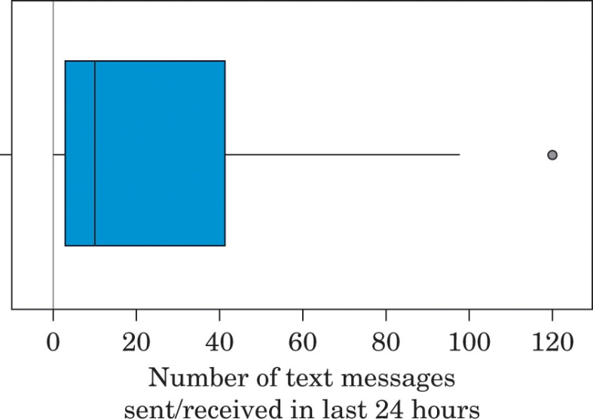
Boxplots
A boxplot is a graph of the five-number summary:
A central box is drawn from the first quartile to the third quartile.
A line in the box marks the median.
Lines extend from the box out to the smallest and largest observations that are not outliers.
But… How do we identify the outliers?

Slide 10
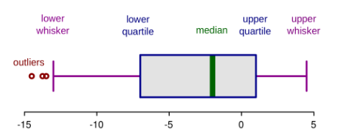

Slide 11
Try this one!
After hearing about the text message study, Mrs. Krebs asked the students in her statistics class how many phone calls they had made or received in the past 24 hours. Here are their responses:
3, 0, 12, 10, 8, 4, 2, 7, 10, 11, 6, 7, 0, 35, 12, 3, 10, 2, 7, 9, 15, 5, 14, 15, 6
a) Find the five-number summary for the data set.
b) Find the IQR and identify any outliers.
c) Construct a boxplot for the given data.

Slide 12
Another Center?
Another measure of center is the mean.
The average of a set of data.
When is it appropriate to use the median or mean as a measure of center?
The median is a resistant measure
It ignores the size of values at either end of the distribution

Slide 13
Let’s See How the Median is Resistant
How many pets do you have?

Slide 14
Is there a Measure of Spread that is Not Resistant?
We measured spread previously with the IQR. Another measure of spread, though, is the standard deviation.
Considered to give the average distance of observations from the mean
Used as the measure of spread when the mean is used as the measure of center
If s=0, it means there is no variability in the data.

Slide 15
How to Calculate Standard Deviation
Find the distance of each observation from the mean and square each of these distances.
Average the distances by dividing their sum by n-1. This average is called the variance.
The standard deviation is the square root of the variance.

Slide 16
One Time!
Let’s calculate the standard deviation of the first five pet totals by hand.
*But don’t worry, we will calculate standard deviation by hand*

Slide 17
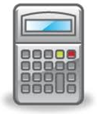
Using Technology
STAT---EDIT---Enter Data into a List (L1)
STAT---CALC---1-Vars Stat
The s_{x} value is your standard deviation
This command provides additional information, such as your mean, quartiles, median, sum, etc

Slide 18
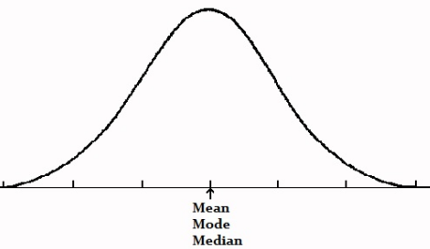
When to Use Each Description
If your data is symmetric:
The mean and median are very close in value
Both IQR and standard are valid measures of spread

Slide 19
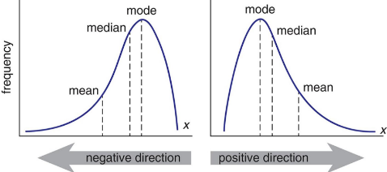
When to Use Each Description
If your data is skewed:
Mean and standard deviation are not resistant measures
They are effected by extreme values
Mean runs away from the median, towards the long tail
Standard deviation is also effected by the long tail
Also, no single s value can describe the spread well
Median and quartiles are much better measures of center and spread

Slide 20
What do you think?
Below is a dotplot describing the distribution of Mrs. Liao’s class grades on a recent exam. Based on the distribution, which measurements should we use to describe it?

Slide 21
Comparing Distributions
How can we effectively answer questions like “Who texts more-males or females”?

Slide 22
Comparing Distributions
Categorical Variables:
Bar graphs and pie charts
Quantitative Data:
Histograms, dotplots, stemplots
AND numerical summaries/boxplots

Slide 23
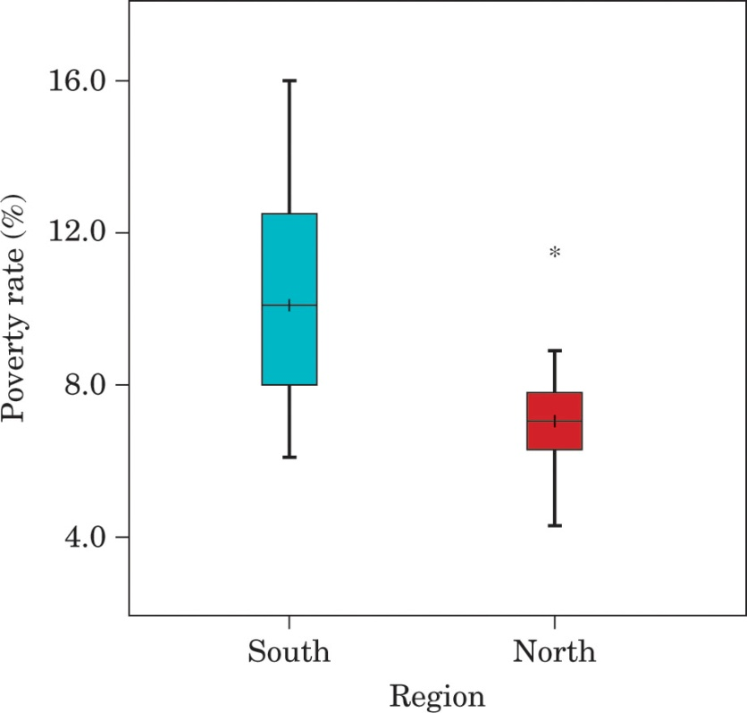
Example
Using the given boxplot below, examine the similarities and differences in poverty levels in state north of the Mississippi River and south of the Mississippi River.

