Slide 1
Do Now
In BIG CLEAR numbers, please write your height in inches on the index card.

Slide 2
Chapter 3: Modeling Distributions of Data
Section 3.1
Describing Location in a Distribution

Slide 3
Chapter 3 Modeling Distributions of Data
3.1 Describing Location in a Distribution
3.2 Normal Distributions

Slide 4
Describing Location in a Distribution
Measuring Position: Percentiles
One way to describe the location of a value in a distribution is to tell what percent of observations are less than it.
Definition:
The p^{th} percentile of a distribution is the value with p percent of the observations less than it.
“You’re the 80th percentile for the class height!”

Slide 5
Example
Jenny earned a score of 86 on her test. How did she perform relative to the rest of the class?
6 7
7 2334
7 5777899
8 00123334
8 569
9 03
Her score was greater than 21 of the 25 observations. Since 21 of the 25, or 84%, of the scores are below hers, Jenny is at the 84th percentile in the class’s test score distribution.

Slide 6
Try This!
Lynette, a student in the class, is 65 inches tall.
Is she tall or short relative to her classmates?
What is your percentile of the distribution of heights in this class?
What height in the dot plot above is at the 80th percentile?
We can see that her height is below average, but how much below average is it?

Slide 7
Describing Location in a Distribution
Measuring Position: z-Scores
A z-score tells us how many standard deviations from the mean an observation falls, and in what direction.
Definition:
If x is an observation from a distribution that has known mean and standard deviation, the standardized value of x is:
A standardized value is often called a z-score.

Slide 8
What About Jenny?
Jenny earned a score of 86 on her test. The class mean is 80 and the standard deviation is 6.07. What is her standardized score?

Slide 9
Describing Location in a Distribution
Using z-scores for Comparison
We can use z-scores to compare the position of individuals in different distributions.
Jenny earned a score of 86 on her statistics test. The class mean was 80 and the standard deviation was 6.07. She earned a score of 82 on her chemistry test. The chemistry scores had a fairly symmetric distribution with a mean 76 and standard deviation of 4. On which test did Jenny perform better relative to the rest of her class?

Slide 10
Where does Lynette's height fall relative to the mean?
Lynette=65 inches

Slide 11
Standardized values and z-scores
We can also use the z-score to compare the locations of individuals in different distributions or different scales.
Example : SAT vs. ACT
Sophia scores 660 on the SAT Math test. The distribution of SAT scores has a mean of 500 and standard deviation of 100.
Jim takes the ACT Math test and scores 26. ACT scores have a mean of 18 and standard deviation of 6.
Assuming that both tests measure the same kind of ability, who did better?
Find the z-score from each to compare...

Slide 12
Standardized values and z-scores
Example: Finding the value
What will be the miles per gallon for a Toyota Camry when the average mpg is 23, it has a z value of 1.5 and a standard deviation of 5?

Slide 13
Describing Location in a Distribution
Density Curves
In Chapter 1, we developed a kit of graphical and numerical tools for describing distributions. Now, we’ll add one more step to the strategy.
Exploring Quantitative Data
Always plot your data: make a graph.
Look for the overall pattern (shape, center, and spread) and for striking departures such as outliers.
Calculate a numerical summary to briefly describe center and spread.
4. Sometimes the overall pattern of a large number of observations is so regular that we can describe it by a smooth curve.

Slide 14
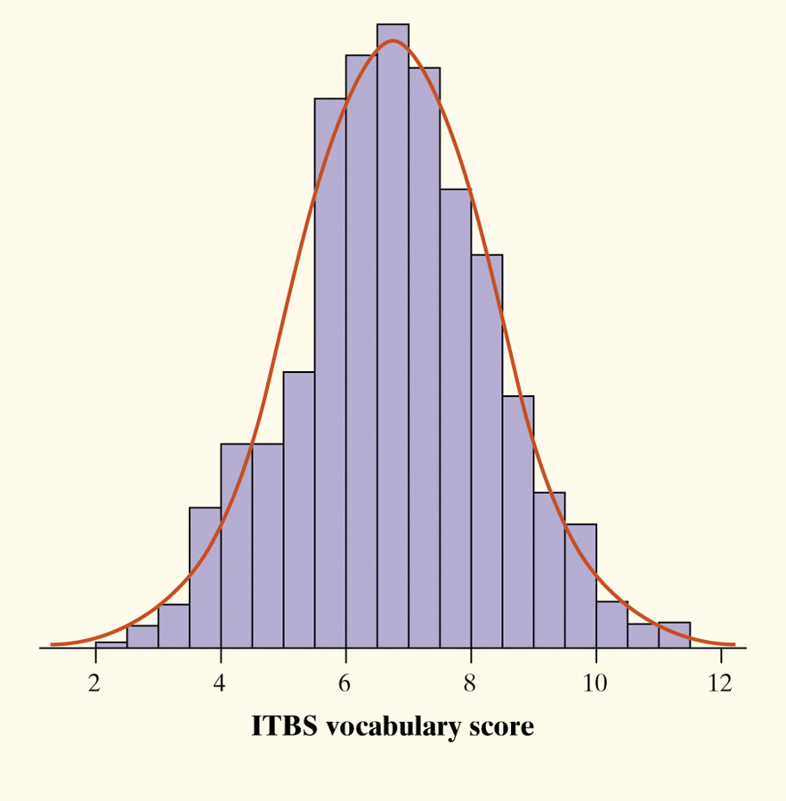
Describing Location in a Distribution
Density Curve
Definition:
A density curve is a curve that
is always on or above the horizontal axis, and
has area exactly 1 underneath it.
A density curve describes the overall pattern of a distribution. The area under the curve and above any interval of values on the horizontal axis is the proportion of all observations that fall in that interval.
The overall pattern of this histogram of the scores of all 947 seventh-grade students in Gary, Indiana, on the vocabulary part of the Iowa Test of Basic Skills (ITBS) can be described by a smooth curve drawn through the tops of the bars.

Slide 15
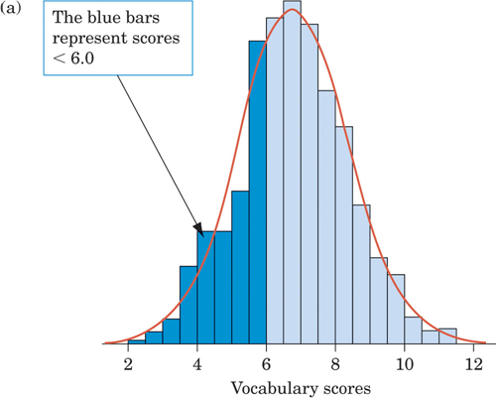
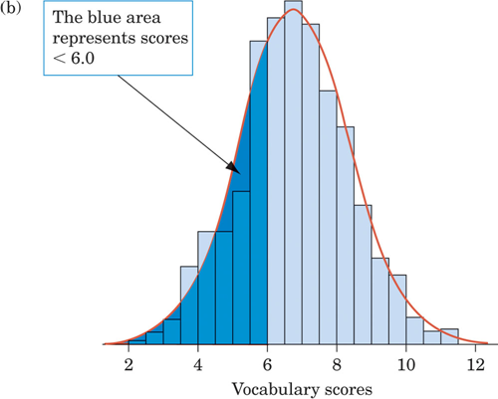
Figure 3.4
(a) The proportion of scores less than 6.0 from the histogram is 0.303.
(b) The proportion of scores less than 6.0 from the density curve is 0.293.

Slide 16
MEDIAN AND QUARTILES
The median of a density curve is the equal-areas point, the point with half the area under the curve to its left and the remaining half of the area to its right.
The quartiles divide the area under the curve into quarters.
¼ of the area under the curve is to the left of the first quartile, and ¾ of the area is to the left of third quartile.

Slide 17
MEAN
The mean of a density curve is the balance point, at which the curve would balance if made of solid material.
The median and mean are the same for a symmetric density curve. They both lie at the center of the curve.
The mean of a skewed curve is pulled away from the median in the direction of the long tail.

Slide 18
If the density curve is perfectly symmetric, the mean = the median.

Slide 19
The median divides the curves area in half. Mean is the balance point; where the curve would balance if its made of solid material.
The mean is pulled
towards the skew or
long tail.

Slide 20
New Symbols
Used to discuss a sample
(mu) Mean
Used to discuss the whole population. We use these symbols when we are discussing density curves and more.
(sigma) Standard Deviation

Slide 21
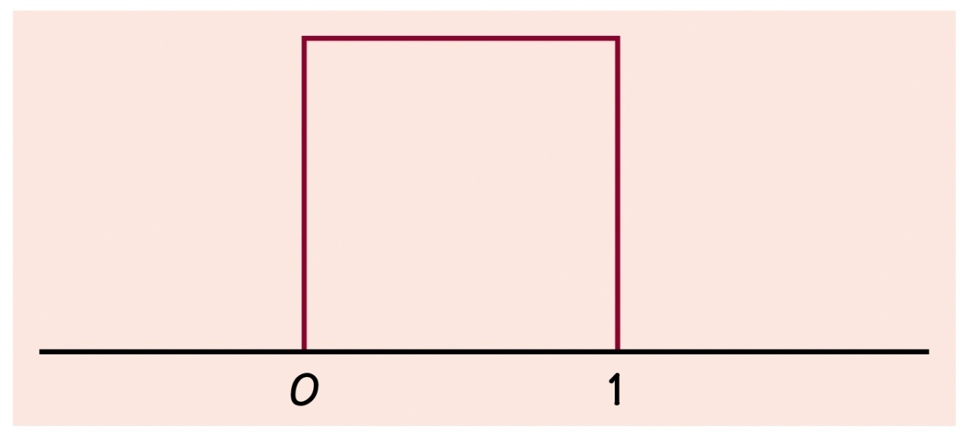
Example 1: A uniform distribution
Why is the total area under this curve equal to 1?
What percent of the observations lie above 0.8?
What percent of the observations lie below 0.6?
What percent of the observations lie between 0.25 and 0.75?
What is the mean, μ of this distribution?

Slide 22
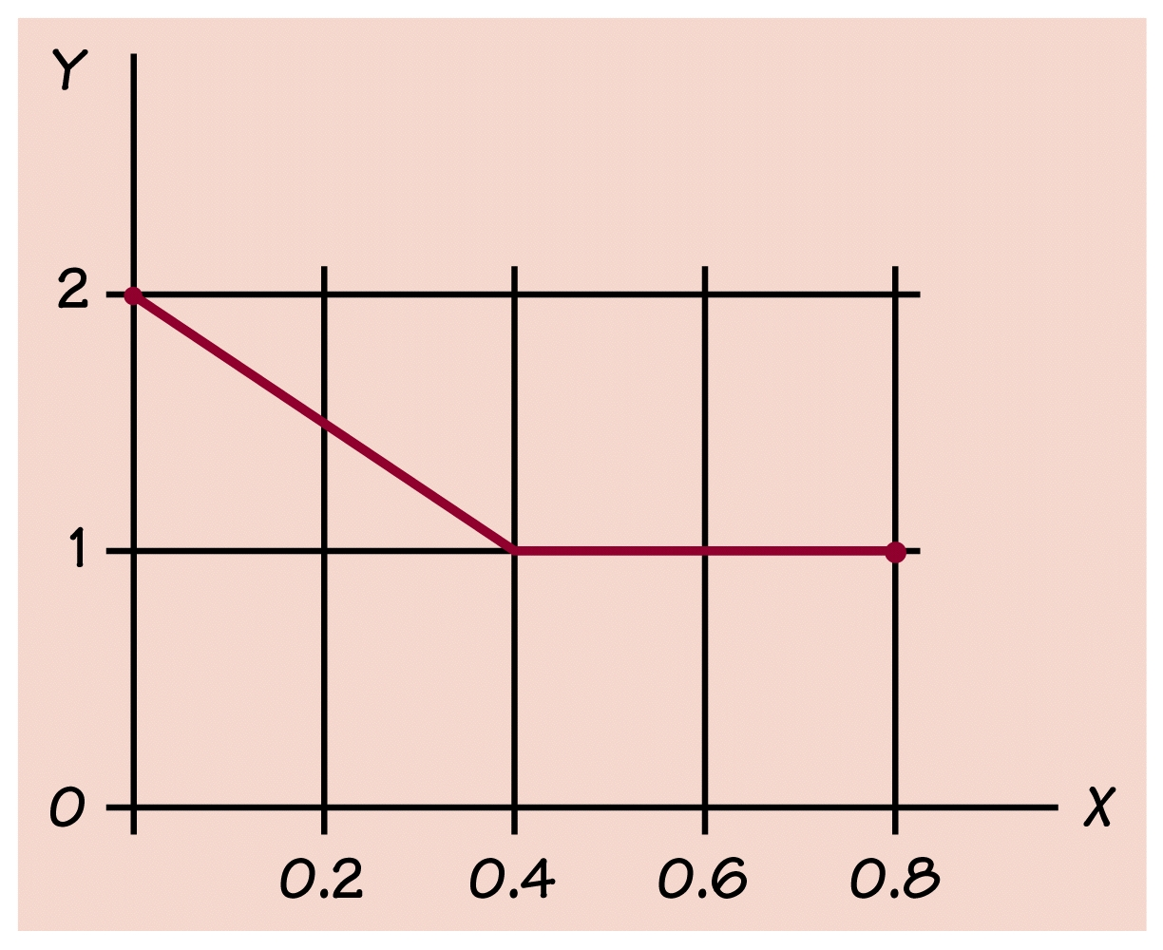
An unusual “broken line” density curve. Use areas under this density curve to find the proportion of observations within the given interval.
Example 2

Slide 23
Example 4
Consider a uniform distribution that outputs
numbers between 0 and 2.
Find P (x < 0.5)
Find P (x > 0.7)
Find P (0.2 < x < 1.2)

Slide 24
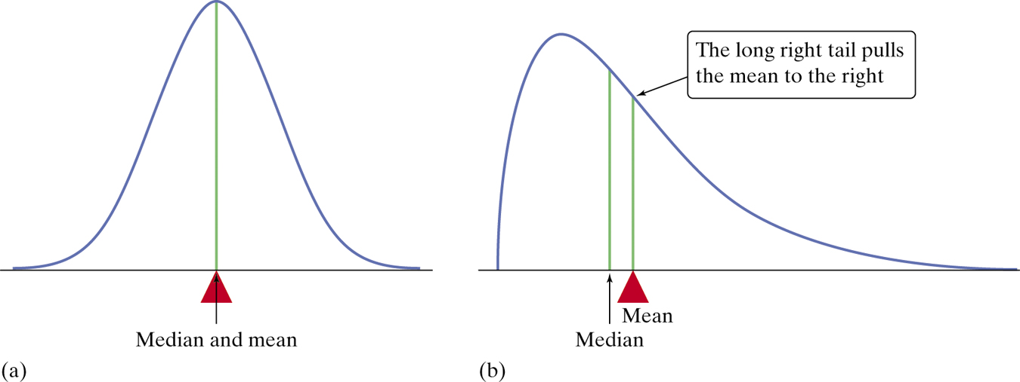
Describing Location in a Distribution
Describing Density Curves
Our measures of center and spread apply to density curves as well as to actual sets of observations.
Distinguishing the Median and Mean of a Density Curve
The median of a density curve is the equal-areas point, the point that divides the area under the curve in half.
The mean of a density curve is the balance point, at which the curve would balance if made of solid material.
The median and the mean are the same for a symmetric density curve. They both lie at the center of the curve. The mean of a skewed curve is pulled away from the median in the direction of the long tail.

Slide 25
Section 3.1 Describing Location in a Distribution
Summary
In this section, we learned that…
There are two ways of describing an individual’s location within a distribution – the percentile and z-score.
A cumulative relative frequency graph allows us to examine location within a distribution.
It is common to transform data, especially when changing units of measurement. Transforming data can affect the shape, center, and spread of a distribution.
We can sometimes describe the overall pattern of a distribution by a density curve (an idealized description of a distribution that smooths out the irregularities in the actual data).

