Slide 1

Chapter 4
Describing Relationships
Section 4.1-Scatterplots and Correlation
Section 4.2 Regression and Prediction

Slide 2
Topic in this chapter-
Relationship between 2 variables
Goal in this chapter:
Plot the data, and add numerical summaries.
Look for overall patterns and deviations from those patterns
When the overall pattern is quite regular, there is sometimes a way to describe it briefly.

Slide 3
Section 3.1
Scatterplots and Correlation
Learning Targets
After this section, you should be able to…
  IDENTIFY explanatory and response variables
  CONSTRUCT scatterplots to display relationships
  INTERPRET scatterplots
  MEASURE linear association using correlation
  INTERPRET correlation

Slide 4
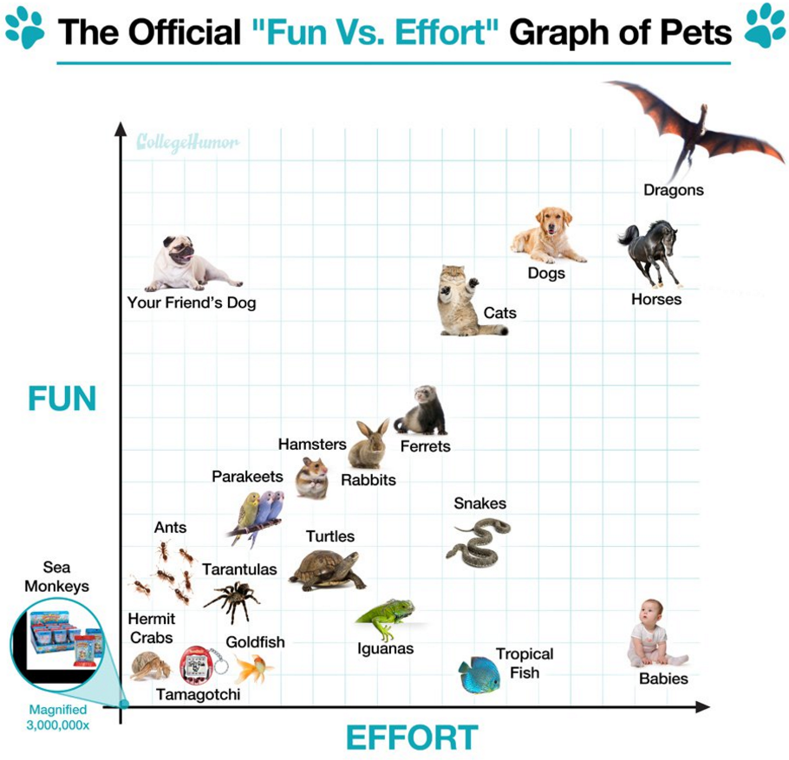

Slide 5
Explanatory and Response Variables
  Most statistical studies examine data on more than one variable. In many of these settings, the two variables play different roles.
Definition:
A response variable measures an outcome (think output) of a study. This is our dependent variable, and is placed on the y-axis.
An explanatory variable may help explain or influence changes in a response variable. This is our independent variable and is placed on the x-axis.
You may remember these from Algebra 2 or your science classes as the “independent” and “dependent” variables.

Slide 6

Looking at your assigned station. Decide which variable is the explanatory variable and which variable is the response variable. How do you know?

Slide 7
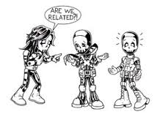
Scatterplots and Correlation
Displaying Relationships: Scatterplots
  The most useful graph for displaying the relationship between two quantitative variables is a scatterplot.
Definition:
A scatterplot shows the relationship between two quantitative variables. The values of one variable appear on the horizontal axis, and the values of the other variable appear on the vertical axis.
There are many situations in which a statistician might like to know if two variables are related and how they are related.

Slide 8
Scatterplots and Correlation
Displaying Relationships: Scatterplots
  The most useful graph for displaying the relationship between two quantitative variables is a scatterplot.
How to Make a Scatterplot
Decide which variable should go on each axis.
  Remember, the eXplanatory variable goes on the X-axis!
Label and scale your axes.
Plot individual data values.
TIP: If you are given a grid, try to adopt a scale so that your plot uses the whole grid. Make your plot large enough so that the details can be easily seen.

Slide 9



Interpreting a Scatterplot
Strength
Is a pattern clearly visible?
Direction
Positive or Negative?
Form
Linear? Curved?

Slide 10
Interpreting a Scatterplot
Look at overall pattern showing form, direction, and
strength of the relationship .
Then look for outliers or other deviations from this pattern.
Form: linear relationships, curved relationships, clusters
Direction: Positive Association or Negative Association
(association is the same as correlation)
Strength: determined by how closely the points in the scatterplot follow a clear form

Slide 11
Examples of Form
Linear
Strong relationships
Weak relationships
Y
Y
X
X
Y
Y
X
X

Slide 12
Scatterplots and Correlation
Interpreting Scatterplots-Direction
Definition:
Two variables have a positive association when the dependent variable increases as the independent variable increases. (y increases with x).
Two variables have a negative association when that the dependent variable decreases as the independent variable increases. (y decreases with x).
We can have no association. The points are scattered randomly and no pattern can be seen.

Slide 13
Positive Association: IQ and GPA
IQ GPA
110 2.5
140 4.0
80 1.0
100 2.0
130 3.5
90 1.5
120 3.0
70 .5

Slide 14
Negative Association: IQ and Errors
IQ Errors
80 14
120 6
100 10
90 12
130 4
110 8
140 2
70 16

Slide 15
No Association: IQ and Weight
IQ Weight
120 170
100 160
70 120
140 130
90 200
130 110
80 150
110 140

Slide 16
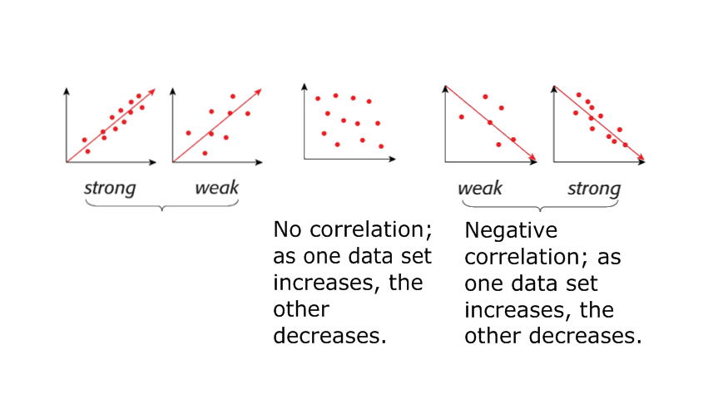
Examples of Strength
Positive
association;
both data sets
increase
together.

Slide 17
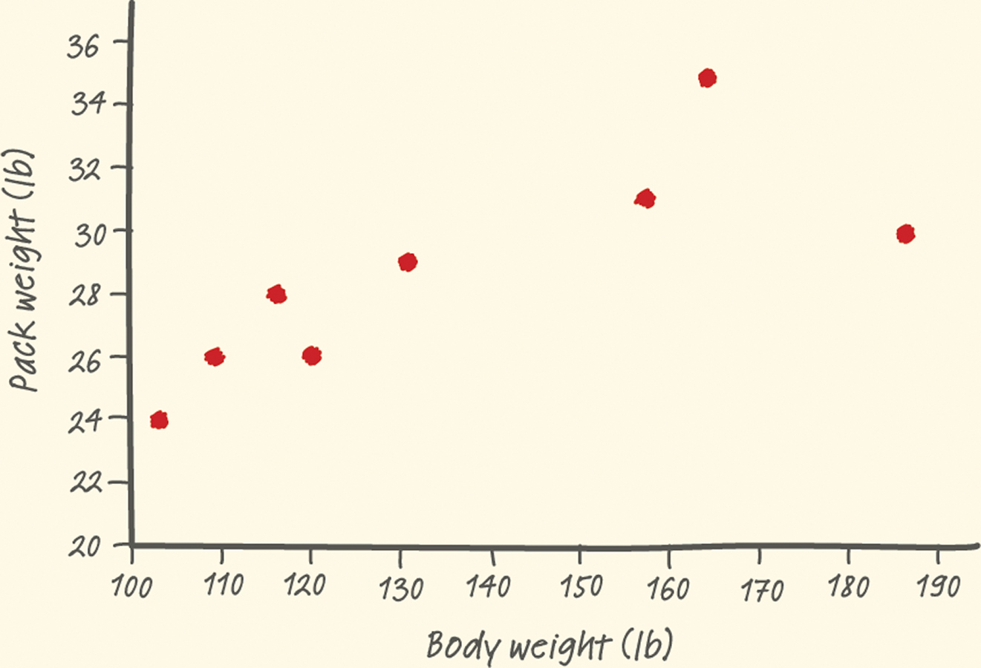
Scatterplots and Correlation
Interpreting Scatterplots-Example
Outlier
There is one possible outlier, the hiker with the body weight of 187 pounds seems to be carrying relatively less weight than are the other group members.

Slide 18
Scatterplots and Correlation
Interpreting Scatterplots
Outlier
There is one possible outlier, the hiker with the body weight of 187 pounds seems to be carrying relatively less weight than are the other group members.
Strength
Direction
Form
There is a moderately strong, positive, linear relationship between body weight and pack weight.
It appears that lighter students are carrying lighter backpacks.

Slide 19
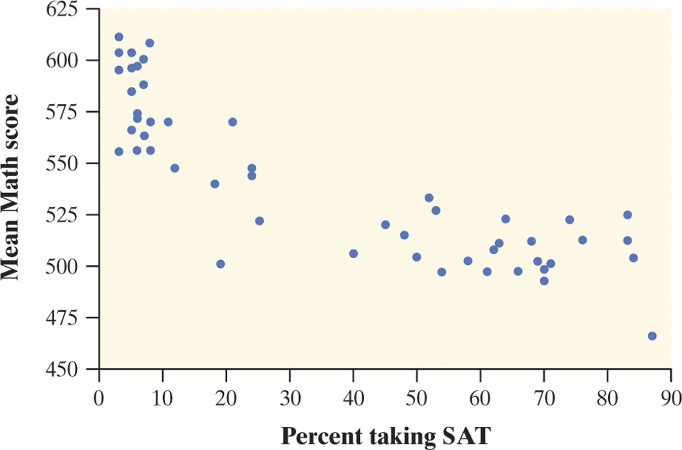
Scatterplots and Correlation
Interpreting Scatterplots
Putting it all Together
There is a moderately strong, negative, curved relationship between the percent of students in a state who take the SAT and the mean SAT math score.

Slide 20
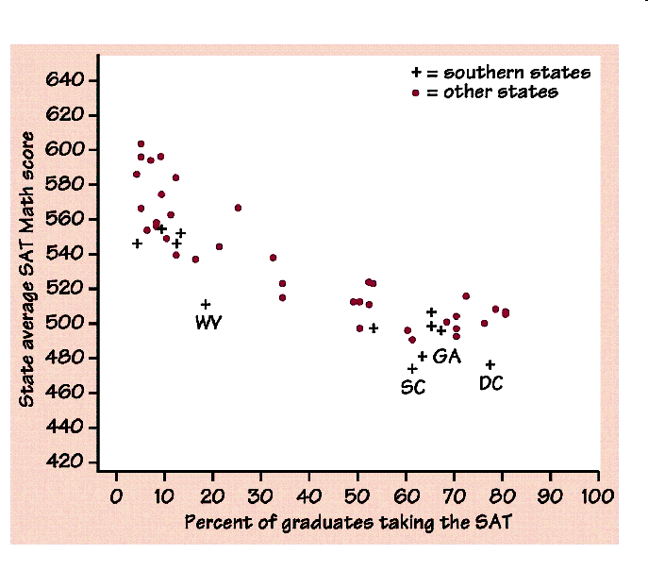

Slide 21
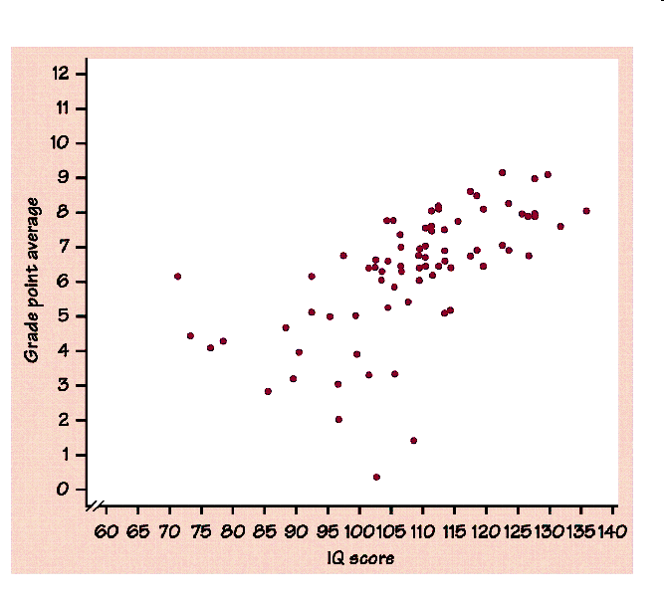

Slide 22

What do you think?
In your groups, examine your scatterplot. Provide a description of the graph and comment on any features or trends that are worth noting.

Slide 23
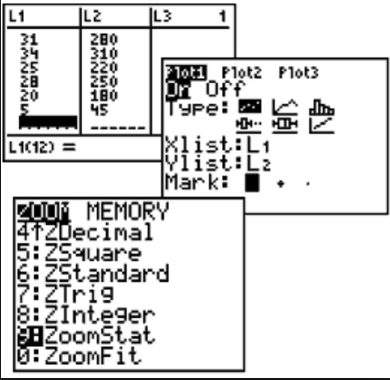
In Your Calculator

Slide 24
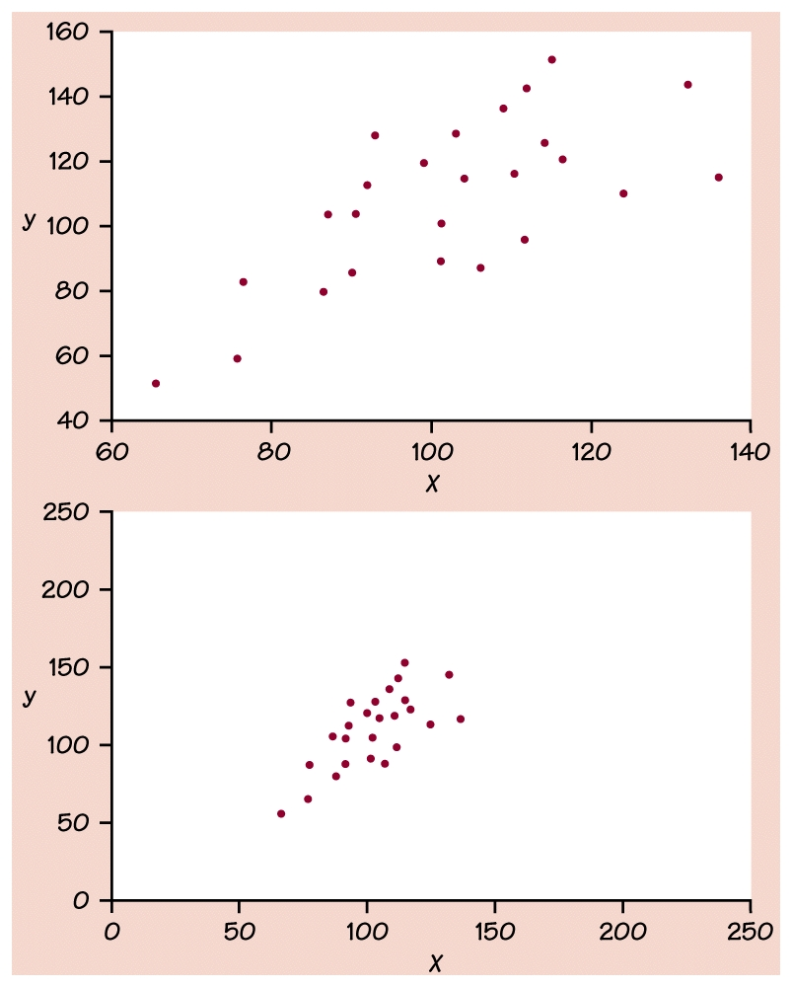
Changing the Scales
Our eyes are not good judges of how strong a linear relationship is.
These 2 scatterplots depict exactly the same data, but the lower plot is drawn smaller in a larger field so it appears to show a stronger linear relationship.
Correlation is the measure we use to accurately determine how strong or weak a relationship actually is.

Slide 25

Scatterplots and Correlation
Measuring Linear Association: Correlation
Definition:
The correlation r measures the strength of the linear relationship between two quantitative variables.
  r is always a number between -1 and 1
  r > 0 indicates a positive association.
  r < 0 indicates a negative association.
  Values of r near 0 indicate a very weak linear relationship.
  The strength of the linear relationship increases as r moves away from 0 towards -1 or 1.
  The extreme values r = -1 and r = 1 occur only in the case of a perfect linear relationship.

Slide 26
Interpretations of positive, zero and negative correlations.
r can take on any values between -1 and 1 inclusive
r = -1 indicates a perfect negative linear correlation
r = 0 indicates no linear correlation
r = 1 indicates a perfect positive linear relationship
Value of r | Strength of relationship
-1 to -.75 or .75 to 1 | strong
-.75 to -.5 or .5 to .75 | moderate
-.5 to -.25 or .25 to .5 | weak
-.25 to .25 | none or very weak

Slide 27
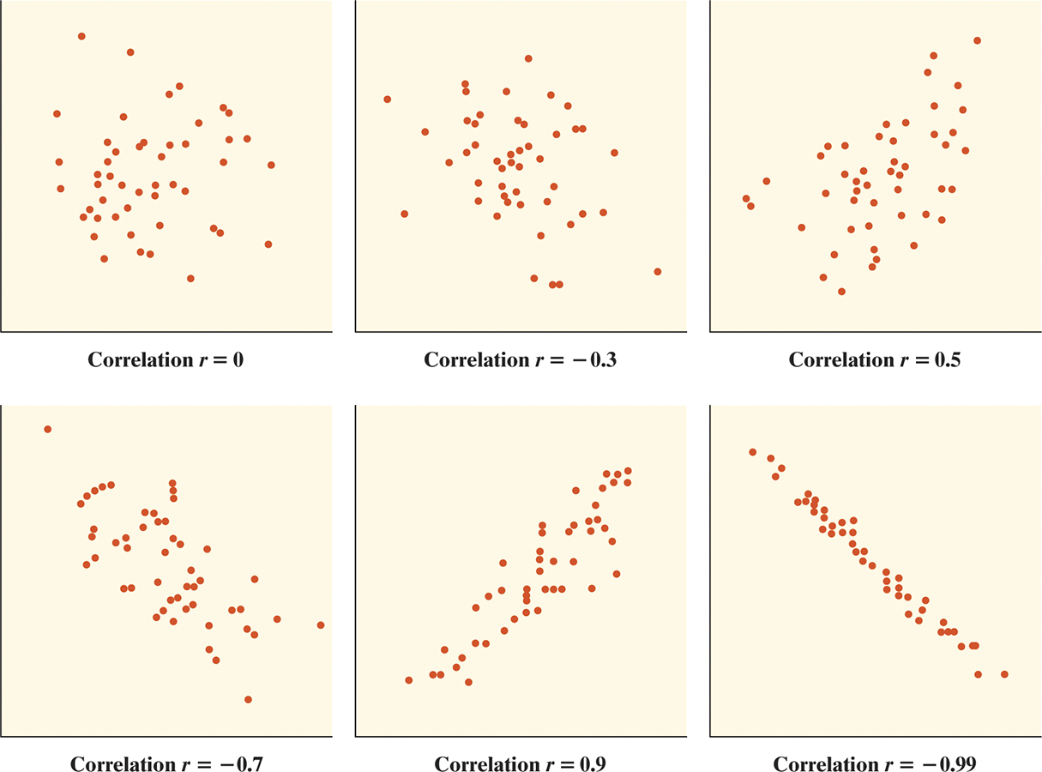
Scatterplots and Correlation
Measuring Linear Association: Correlation

Slide 28
Measuring Linear Association: Correlation

Slide 29
Scatterplots and Correlation
Correlation
  The formula for r is a bit complex. It helps us to see what correlation is, but in practice, you should use your calculator to find r.
How to Calculate the Correlation r
Suppose that we have data on variables x and y for n individuals.
The values for the first individual are x₁ and y₁, the values for the second individual are x₂ and y₂, and so on.
The means and standard deviations of the two variables are x-bar and s_{x} for the x-values and y-bar and s_{y} for the y-values.
The correlation r between x and y is:

Slide 30
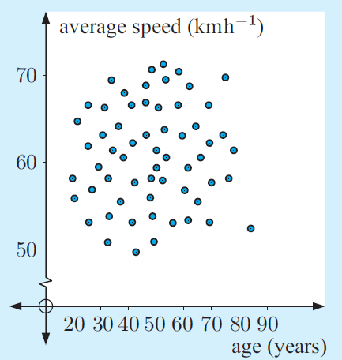
1) Average speed in the metropolitan area and age of drivers
Example
The r-value for this association is 0.027. Describe the association.

Slide 31
Scatterplots and Correlation
Facts about Correlation
  Here are some important facts about r.
Correlation makes no distinction between explanatory and response variables.
r does not change when we change the units of measurement of x, y, or both.
The correlation r itself has no unit of measurement.
r is strongly affected by outliers.
Correlation:
Correlation requires that both variables be quantitative.
Correlation does not describe curved relationships between variables.
Correlation is not a complete summary of two-variable data. You should give the means and standard deviations of both x and y along with the correlation.

Slide 32
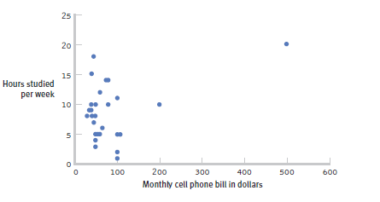
The effect of an outliner
One individual who both studies and uses her cell phone more than any other individual in the sample changed the correlation, r from -0.14, a negative correlation, to 0.39, a much stronger and positive correlation!

Slide 33
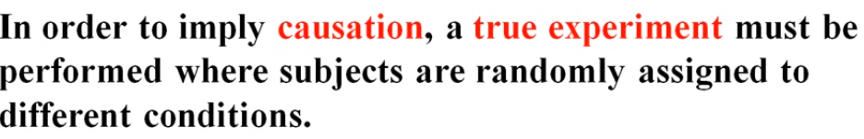

Does Correlation Imply Causation?
If we have a high correlation between two variables, does the explanatory variable cause the response variable?
Does a high correlation imply causation?

Slide 34
Caution!
Correlation does not indicate causation.
Correlation only establishes that a relationship exists
Examples:
Amount of ice sold and number of bee stings.
SAT scores and GPA in college.

Slide 35
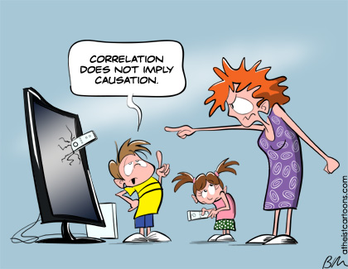


Slide 36
Section 3.1
Scatterplots and Correlation Summary
Summary
In this section, we learned that…
  A scatterplot displays the relationship between two quantitative variables.
  An explanatory variable may help explain, predict, or cause changes in a response variable.
  When examining a scatterplot, look for an overall pattern showing the direction, form, and strength of the relationship and then look for outliers or other departures from the pattern.
  The correlation r measures the strength and direction of the linear relationship between two quantitative variables.

