Slide 1
Chapter 5: Producing Data
Introduction/ Section 5.1
Designing Samples

Slide 2
Introduction
We know how to describe data in various ways
Visually, Numerically, etc
Now, we’ll focus on producing data to answer questions about large groups.
Both good techniques and bad techniques exist

Slide 3
Observational Study Vs. Experiment
Observational Study: Observes individuals and measures variables of interest but does not attempt to influence the responses
Experiment: Deliberately imposes some treatment on individuals in order to observe their responses
Think about your Do Now activities. Were they observational studies or experiments?

Slide 4
What do you think?
A study of child care enrolled 1364 children in 1991 and planned to follow them through their school. In 2003, the researchers published an article finding that “the more time children spent in child care from birth to age four-and-a-half, the more adults tended to rate them, both at age four-and-a-half and at kindergarten, as less likely to get along with others, as more assertive, as disobedient, and as aggressive.”
Observational Study or experiment?

Slide 5
Section 5.1 : Designing Samples
A political scientist wants to know what percent of the voting-age population consider themselves conservatives.
Wants to gather info on a large group of individuals
Not going to impose a treatment in order to observe a response (Differing from an experiment)
Time, cost, and inconvenient to contact EVERYONE
So, information is gathered about part of the group in order to draw conclusions about the whole

Slide 6
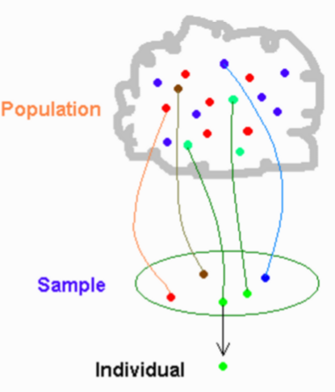
Vital Vocab
Sampling: gaining information about the whole by examining only a part
Sample surveys: observational studies that involve sampling
Population: the entire group of individuals about which we want information
Sample: a part of the population from which we actually collect information, which is then used to draw conclusions about the whole
Census: a sample survey that attempts to include the entire population in the sample

Slide 7
Sampling Methods
Design of a sample refers to the method used to choose the sample from the population
Poor sample designs can lead to misleading conclusions.
Biased Sampling Methods
~ The design of a statistical study is biased if it systematically favors certain outcomes
Voluntary Response Sample:
Consists of people who choose themselves by responding to a general appeal.
Biased because people with strong opinions, especially negative, are most likely to respond
Convenience Sampling:
Choosing individuals who are easiest to reach
* Both types choose a sample that is almost guaranteed not to represent the entire population

Slide 8
A Better Plan
Since these methods display bias or systematic error, we have a better plan.
Let chance select the sample!
All individuals have an equal chance of being chosen
Simple Random Sample (SRS)!

Slide 9
SRS
Simple Random Sample (SRS) of size n consists of n individuals chosen in such a way that every set of n individuals has an equal chance to be the sample actually selected.
Choose an SRS in four steps:
Label: Assign a numerical label to every individual in the population. Often called sampling frame. Use the shortest possible labels and be sure that all labels have the same number of digits.
Table: Use a random digits table (or random number generator) to select labels at random.
Stopping Rule: Indicate when you should stop sampling.
Identify sample: Use the labels to identify subjects selected to be in the sample.
**** Specify if you are sampling without replacement or sampling with replacement****

Slide 10
Random Digits
Each pair of entries is equally likely to be any of the 100 possible pairs 00, 01, 02,… 99.
Each pair of entries is equally likely to be any of the 1000 possible pairs 000, 001, 002,… 999.
These “equally likely” facts make it easy to use Table B.
Table B: Digits in groups of five and numbered row (Rows and groups have no meaning)

Slide 11
Joan’s Accounting Firm
Joan’s small accounting firm serves 30 business clients. Joan wants to interview a sample of 5 clients in detail to find ways to improve client satisfaction.

Slide 12
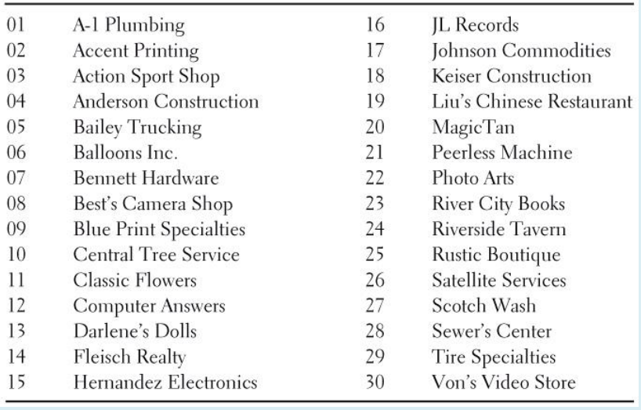
Label!
Give each client a numerical label

Slide 13
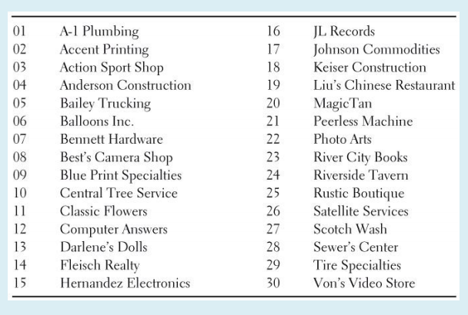
Table
Enter Table B anywhere and read two digit groups. For this example, lets start at line 130.

Slide 14
Stopping Rule and Identifying the Sample
Stopping Rule:
Use line 130 and continue to line 131 if needed until five clients are chosen.
69 05 16 48 17 87 17 40 95 17 84 53 40 64 89 87 20 19
Identifying the Sample:
05 16 17 20 19
Bailey Trucking, JL Records, Johnson Commodities, Magic Tan, Liu’s Chinese Restaurant

Slide 15
Random Number Generator
MATH
PRB
Randint(lowest #, highest #, # of people you want in your sample)
Select 5clients using the Random Number Generator

Slide 16
Probability Sample
General framework for designs that use chance to choose a sample
An SRS is an example
Other methods can be more elaborate, but all use chance
An SRS may not be the most practical in a given situation

Slide 17
Designs for Sampling
Sampling large populations that are more spread out are more complex than an SRS
Common to sample important groups within the population separately

Slide 18
Sampling Designs
Stratified
First divide the population into groups of individuals, called strata, that are similar in some way to the response
Choose an SRS in each stratum and combine these SRS’s
Cluster
Divides the population into groups or clusters
Some clusters are randomly selected.
All individuals in the chosen cluster are sampled

Slide 19
Cautions
Undercoverage:
Who might we miss in a survey of households?
Who might we miss in a phone survey?
Nonresponse:
Nonreponse to sample surveys often reaches 30% or more, even with careful planning and several callbacks.

Slide 20
Cautions
Response Bias:
Can be cause by the behavior of the respondent or the interviewer
Most important influence on the answers given to a sample survey is the wording of the questions.
Examples: untruthful responses, attitudes of the interviewer that indicate desirable answers, influences caused by race or gender
Reduced by careful training and supervision of interviewers

Slide 21
Cautions
Because of nonresponse, response bias, and the difficulty of posing clear and neutral questions, you should hesitate to fully trust reports about complicated issues based on surveys of large human populations.
Insist on knowing the exact questions asked, the rate of nonresponse, and the date and method of the survey before you trust a poll result.
Larger random samples give more accurate results than smaller samples.

