Slide 1
Do Now:
Graph the following:
Y=3x

Slide 2
Objective
Solve problems involving direct, inverse, joint, and combined variation.

Slide 3
One special type of linear function is called direct variation.
A direct variation is a relationship between two variables x and y that can be written in the form y = kx, where k ≠ 0.
In this relationship, k is the constant of variation. For the equation y = kx, y varies directly as x.
A direct variation equation is a linear equation in the form y = mx + b, where b = 0 and the constant of variation k is the slope. Because b = 0, the graph of a direct variation always passes through the origin.

Slide 4
Example 1: Writing and Graphing Direct Variation
Given: y varies directly as x, and y = 27 when x = 6. Write and graph the direct variation function.
y = kx
y varies directly as x.

Slide 5
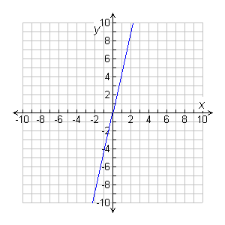
Example 1 Continued
Graph the direct variation function.
The y-intercept is 0, and the slope is 4.5.
Check Substitute the original values of x and y into the equation.
y = 4.5x
27 4.5(6)
27 27
✓

Slide 6
Helpful Hint
If k is positive in a direct variation, the value of y increases as the value of x increases.

Slide 7
Check It Out! Example 1
Given: y varies directly as x, and y = 6.5 when x = 13. Write and graph the direct variation function.

Slide 8
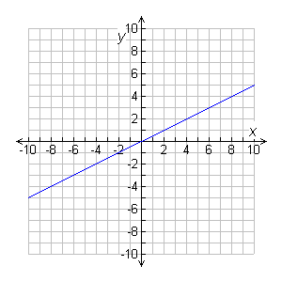
Check It Out! Example 1 Continued
Graph the direct variation function.
The y-intercept is 0, and the slope is 0.5.
Check Substitute the original values of x and y into the equation.
y = 0.5x
6.5 0.5(13)
6.5 6.5
✓

Slide 9
When you want to find specific values in a direct variation problem, you should solve for k and then use substitution to find the other values.

Slide 10
Example 2: Solving Direct Variation Problems
The cost of an item in euros e varies directly as the cost of the item in dollars d, and e = 3.85 euros when d = $5.00. Find d when e = 10.00 euros.

Slide 11
Check It Out! Example 2
The perimeter P of a regular dodecagon varies directly as the side length s, and P = 18 in. when s = 1.5 in. Find s when P = 75 in.

Slide 12
A joint variation is a relationship among three variables that can be written in the form y = kxz, where k is the constant of variation. For the equation y = kxz, y varies jointly as x and z.
Reading Math
The phrases “y varies directly as x” and “y is directly proportional to x” have the same meaning.

Slide 13
Example 3: Solving Joint Variation Problems
The volume V of a cone varies jointly as the area of the base B and the height h, and V = 12π ft³ when B = 9π ft³ and h = 4 ft. Find b when V = 24π ft³ and h = 9 ft.

Slide 14
Check It Out! Example 3
The lateral surface area L of a cone varies jointly as the area of the base radius r and the slant height l, and L = 63π m² when r = 3.5 m and l = 18 m. Find r to the nearest tenth when L = 8π m² and l = 5 m.

Slide 15
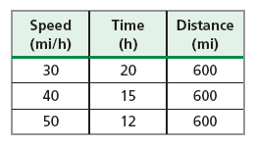
A third type of variation describes a situation in which one quantity increases and the other decreases. For example, the table shows that the time needed to drive 600 miles decreases as speed increases.
This type of variation is an inverse variation.
An inverse variation is a relationship between two variables x and y that can be written in the form y = , where k ≠ 0. For the equation y = , y varies inversely as x.
k
k
x
x

Slide 16
Example 4: Writing and Graphing Inverse Variation
Given: y varies inversely as x, and y = 4 when x = 5. Write and graph the inverse variation function.

Slide 17
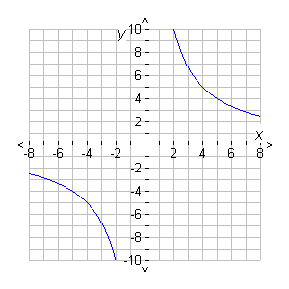
Example 4 Continued
To graph, make a table of values for both positive and negative values of x. Plot the points, and connect them with two smooth curves. Because division by 0 is undefined, the function is undefined when x = 0.
x | y
–2 | –10
–4 | –5
–6 | –
–8 | –
x | y
2 | 10
4 | 5
6
8
10
10
3
3
5
5
2
2

Slide 18
Check It Out! Example 4
Given: y varies inversely as x, and y = 4 when x = 10. Write and graph the inverse variation function.

Slide 19
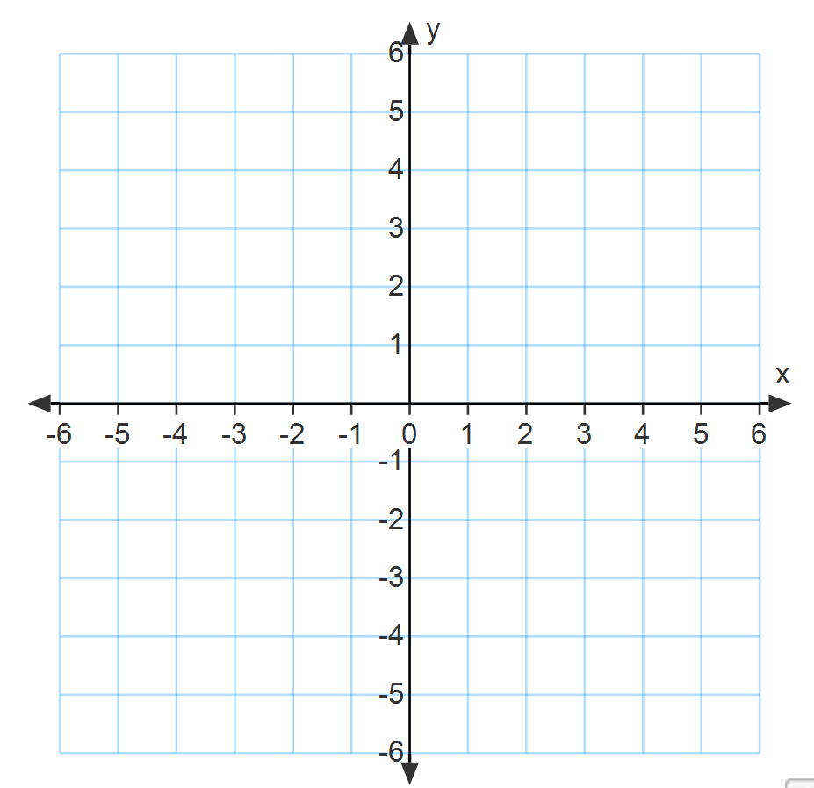
x | y
x | y

Slide 20
When you want to find specific values in an inverse variation problem, you can solve for k and then use substitution or you can use the equation derived below.

Slide 21
Example 5: Sports Application
The time t needed to complete a certain race varies inversely as the runner’s average speed s. If a runner with an average speed of 8.82 mi/h completes the race in 2.97 h, what is the average speed of a runner who completes the race in 3.5 h?

Slide 22
Check It Out! Example 5
The time t that it takes for a group of volunteers to construct a house varies inversely as the number of volunteers v. If 20 volunteers can build a house in 62.5 working hours, how many working hours would it take 15 volunteers to build a house?

Slide 23
Direct variation, the ratio of the two quantities is constant.
Inverse variation, the product of the two quantities is constant.

Slide 24
Example 6: Identifying Direct and Inverse Variation
Determine whether each data set represents a direct variation, an inverse variation, or neither.
A.
x | 6.5 | 13 | 104
y | 8 | 4 | 0.5
B.
x | 5 | 8 | 12
y | 30 | 48 | 72

Slide 25
Example 6: Identifying Direct and Inverse Variation
Determine whether each data set represents a direct variation, an inverse variation, or neither.
C.
x | 3 | 6 | 8
y | 5 | 14 | 21

Slide 26
Check It Out! Example 6
Determine whether each data set represents a direct variation, an inverse variation, or neither.
6a.
x | 3.75 | 15 | 5
y | 12 | 3 | 9
6b.
x | 1 | 40 | 26
y | 0.2 | 8 | 5.2

Slide 27
A combined variation is a relationship that contains both direct and inverse variation. Quantities that vary directly appear in the numerator, and quantities that vary inversely appear in the denominator.

Slide 28
Example 7: Chemistry Application
The change in temperature of an aluminum wire varies inversely as its mass m and directly as the amount of heat energy E transferred. The temperature of an aluminum wire with a mass of 0.1 kg rises 5°C when 450 joules (J) of heat energy are transferred to it. How much heat energy must be transferred to an aluminum wire with a mass of 0.2 kg raise its temperature 20°C?

Slide 29
The volume V of a gas varies inversely as the pressure P and directly as the temperature T. A certain gas has a volume of 10 liters (L), a temperature of 300 kelvins (K), and a pressure of 1.5 atmospheres (atm). If the gas is heated to 400K, and has a pressure of 1 atm, what is its volume?

