Slide 1
Chapter 10: Estimating with Confidence
Section 10.1
Confidence Intervals: The Basics

Slide 2
Confidence Intervals: The Basics
Introduction
Our goal in many statistical settings is to use a sample statistic to estimate a population parameter. We learned if we randomly select the sample, we should be able to generalize our results to the population of interest.
We learned that different samples yield different results for our estimate. Statistical inference uses the language of probability to express the strength of our conclusions by taking chance variation due to random selection or random assignment into account.
In this chapter, we’ll learn one method of statistical inference – confidence intervals – so we may estimate the value of a parameter from a sample statistic. As we do so, we’ll learn not only how to construct a confidence interval, but also how to report probabilities that would describe what would happen if we used the inference method many times.

Slide 3
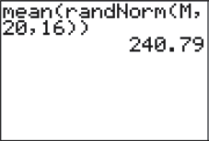
Confidence Intervals: The Basics
Activity: The Mystery Mean
Your teacher has selected a “Mystery Mean” value µ and stored it as “M” in their calculator. Your task is to work together with 3 or 4 students to estimate this value.
The following command was executed on their calculator: mean(randNorm(M,20,16))
The result was 240.79. This tells us the calculator chose an SRS of 16 observations from a Normal population with mean M and standard deviation 20. The resulting sample mean of those 16 values was 240.79.
Your group must determine an interval of reasonable values for the population mean µ. Use the result above and what you learned about sampling distributions in the previous chapter.
Share your team’s results with the class.

Slide 4
Confidence Intervals: The Basics
Confidence Intervals: The Basics
Definition:
A point estimator is a statistic that provides an estimate of a population parameter. The value of that statistic from a sample is called a point estimate. Ideally, a point estimate is our “best guess” at the value of an unknown parameter.
We learned in Chapter 7 that an ideal point estimator will have no bias and low variability. Since variability is almost always present when calculating statistics from different samples, we must extend our thinking about estimating parameters to include an acknowledgement that repeated sampling could yield different results.

Slide 5
Confidence Intervals: The Basics
The Idea of a Confidence Interval
Recall the “Mystery Mean” Activity. Is the value of the population mean µ exactly 240.79? Probably not. However, since the sample mean is 240.79, we could guess that µ is “somewhere” around 240.79. How close to 240.79 is µ likely to be?
To answer this question, we must ask another:

Slide 6
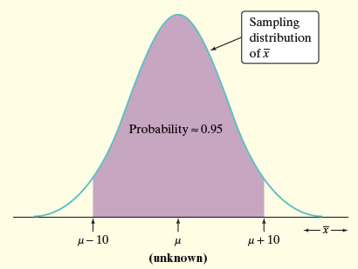
Confidence Intervals: The Basics
The Idea of a Confidence Interval
If we estimate that µ lies somewhere in the interval 230.79 to 250.79, we’d be calculating an interval using a method that captures the true µ in about 95% of all possible samples of this size.

Slide 7
Reminder
Suppose the mean SAT Math score for a sample of 500 California seniors. The mean SAT score was x-bar=461 with a standard deviation of 100 points. Assume that the sample population of high school student SAT scores is Normally distributed. What would be the 95% confidence interval for the true population mean?

Slide 8
Confidence Intervals: The Basics
The Idea of a Confidence Interval
estimate ± margin of error
Definition:
A confidence interval for a parameter has two parts:
An interval calculated from the data, which has the form:
estimate ± margin of error
The margin of error tells how close the estimate tends to be to the unknown parameter in repeated random sampling.
A confidence level C, the overall success rate of the method for calculating the confidence interval. That is, in C% of all possible samples, the method would yield an interval that captures the true parameter value.
We usually choose a confidence level of 90% or higher because we want to be quite sure of our conclusions. The most common confidence level is 95%.

Slide 9
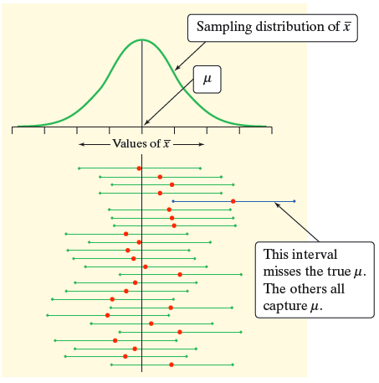
Confidence Intervals: The Basics
Interpreting Confidence Levels and Confidence Intervals
The confidence level is the overall capture rate if the method is used many times. Starting with the population, imagine taking many SRSs of 16 observations. The sample mean will vary from sample to sample, but when we use the method estimate ± margin of error to get an interval based on each sample, 95% of these intervals capture the unknown population mean µ.
Interpreting Confidence Level and Confidence Intervals
Confidence level: To say that we are 95% confident is shorthand for “95% of all possible samples of a given size from this population will result in an interval that captures the unknown parameter.”
Confidence interval: To interpret a C% confidence interval for an unknown parameter, say, “We are C% confident that the interval from _____ to _____ captures the actual value of the [population parameter in context].”

Slide 10
Confidence Intervals: The Basics
Interpreting Confidence Levels and Confidence Intervals
The confidence level tells us how likely it is that the method we are using will produce an interval that captures the population parameter if we use it many times.
The confidence level does not tell us the chance that a particular confidence interval captures the population parameter.
Instead, the confidence interval gives us a set of plausible values for the parameter.
We interpret confidence levels and confidence intervals in much the same way whether we are estimating a population mean, proportion, or some other parameter.

Slide 11
Example
A New York Times poll on women’s issues interviewed 1025 women randomly selected from the United States, excluding Alaska and Hawaii. The poll found that 47% of the women said they do not get enough time for themselves.
A) The poll announced the margin of error of ±3 percentage points for 95% confidence in its conclusions. What is the 95% confidence interval for the percent of all adult women who think they do not get enough time to themselves?
B) Explain to someone who knows no statistics why we can’t just say that 47% of all women do not get enough time for themselves.
C) Then explain clearly what 95% confidence interval means.

Slide 12
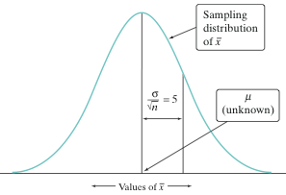
Confidence Intervals: The Basics
Constructing a Confidence Interval
Why settle for 95% confidence when estimating a parameter? The price we pay for greater confidence is a wider interval.
When we calculated a 95% confidence interval for the mystery mean µ, we started with
estimate ± margin of error
This leads to a more general formula for confidence intervals:
statistic ± (critical value) • (standard deviation of statistic)

Slide 13
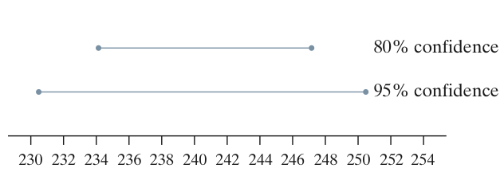
Confidence Intervals: The Basics
Calculating a Confidence Interval
Calculating a Confidence Interval
The confidence interval for estimating a population parameter has the form
statistic ± (critical value) • (standard deviation of statistic)
where the statistic we use is the point estimator for the parameter.
Properties of Confidence Intervals:
The “margin of error” is the (critical value) • (standard deviation of statistic)
The user chooses the confidence level, and the margin of error follows from this choice.
The critical value depends on the confidence level and the sampling distribution of the statistic.
Greater confidence requires a larger critical value
The standard deviation of the statistic depends on the sample size n
The margin of error gets smaller when:
The confidence level decreases
The sample size n increases

Slide 14
Critical Values
In general, the confidence level C will capture the central area. So, to determine the critical value we can calculate the leftover tail area by
(1-C)/2
Common Confidence Levels
Confidence Level | Tail Area | Critical Value
90% | 0.05 | 1.645
95% | 0.025 | 1.960
99% | 0.005 | 2.576

Slide 15
Confidence Intervals: The Basics
Using Confidence Intervals
Before calculating a confidence interval for µ or p there are three important conditions that you should check.
1) Random: The data should come from a well-designed random sample or randomized experiment.
2) Normal: The sampling distribution of the statistic is approximately Normal.
For means: The sampling distribution is exactly Normal if the population distribution is Normal. When the population distribution is not Normal, then the central limit theorem tells us the sampling distribution will be approximately Normal if n is sufficiently large (n ≥ 30).
For proportions: We can use the Normal approximation to the sampling distribution as long as np ≥ 10 and n(1 – p) ≥ 10.
3) Independent: Individual observations are independent. When sampling without replacement, the sample size n should be no more than 10% of the population size N (the 10% condition) to use our formula for the standard deviation of the statistic.

Slide 16
Example
Crop researchers plant 15 plots with a new variety of corn. The yeilds in bushels par acre are:
138.0, 139.1, 113.0, 132.5, 140.7, 109.7, 118.9, 134.8, 109.6, 127.3, 115.6, 130.4, 130.2, 111.7, 105.5
Assume that = 10 bushels.
Find the 90% confidence interval for the mean yield µ for this variety of corn.
Find the 95% confidence interval.
Find the 99% confidence interval.
How do the margins of error in a, b, and c change as the confidence interval increases?

Slide 17
How Confidence Intervals Behave
Margin of error gets smaller when:
Smaller critical value. To obtain a smaller margin of error from the same data, you must be willing to accept lower confidence.
⬧ gets smaller. The standard deviation measures the variation in the population. It is easier to pin down µ when  is small.
n gets larger.

Slide 18
Choosing a Sample Size
A wise user of statistics never plans data collection without planning the inference at the same time.
You can arrange to have both high confidence and small margin of error by taking enough observations.
Let m be your desired margin of error and solve for n(using the given critical value and standard deviation).

Slide 19
Example
Company management wants a report of the mean screen tension for the day’s production to be within 5 mV with 95% confidence interval. How large a sample of video monitors be measured to comply with this request?(Suppose  = 43).

Slide 20
Cautions
The data must be an SRS from the population.
The formula is not correct for probability sampling designs more complex than an SRS.
There is no correct method for inference from data haphazardly collected with bias of unknown size.
Because x-bar is strongly influenced by a few extreme observations, outliers can have a large effect on the confidence interval.
If the sample size is small and the population is not normal, the true confidence level will be different from the value C used in computing the interval.
You must know the standard deviation of the population.

